Slide 1
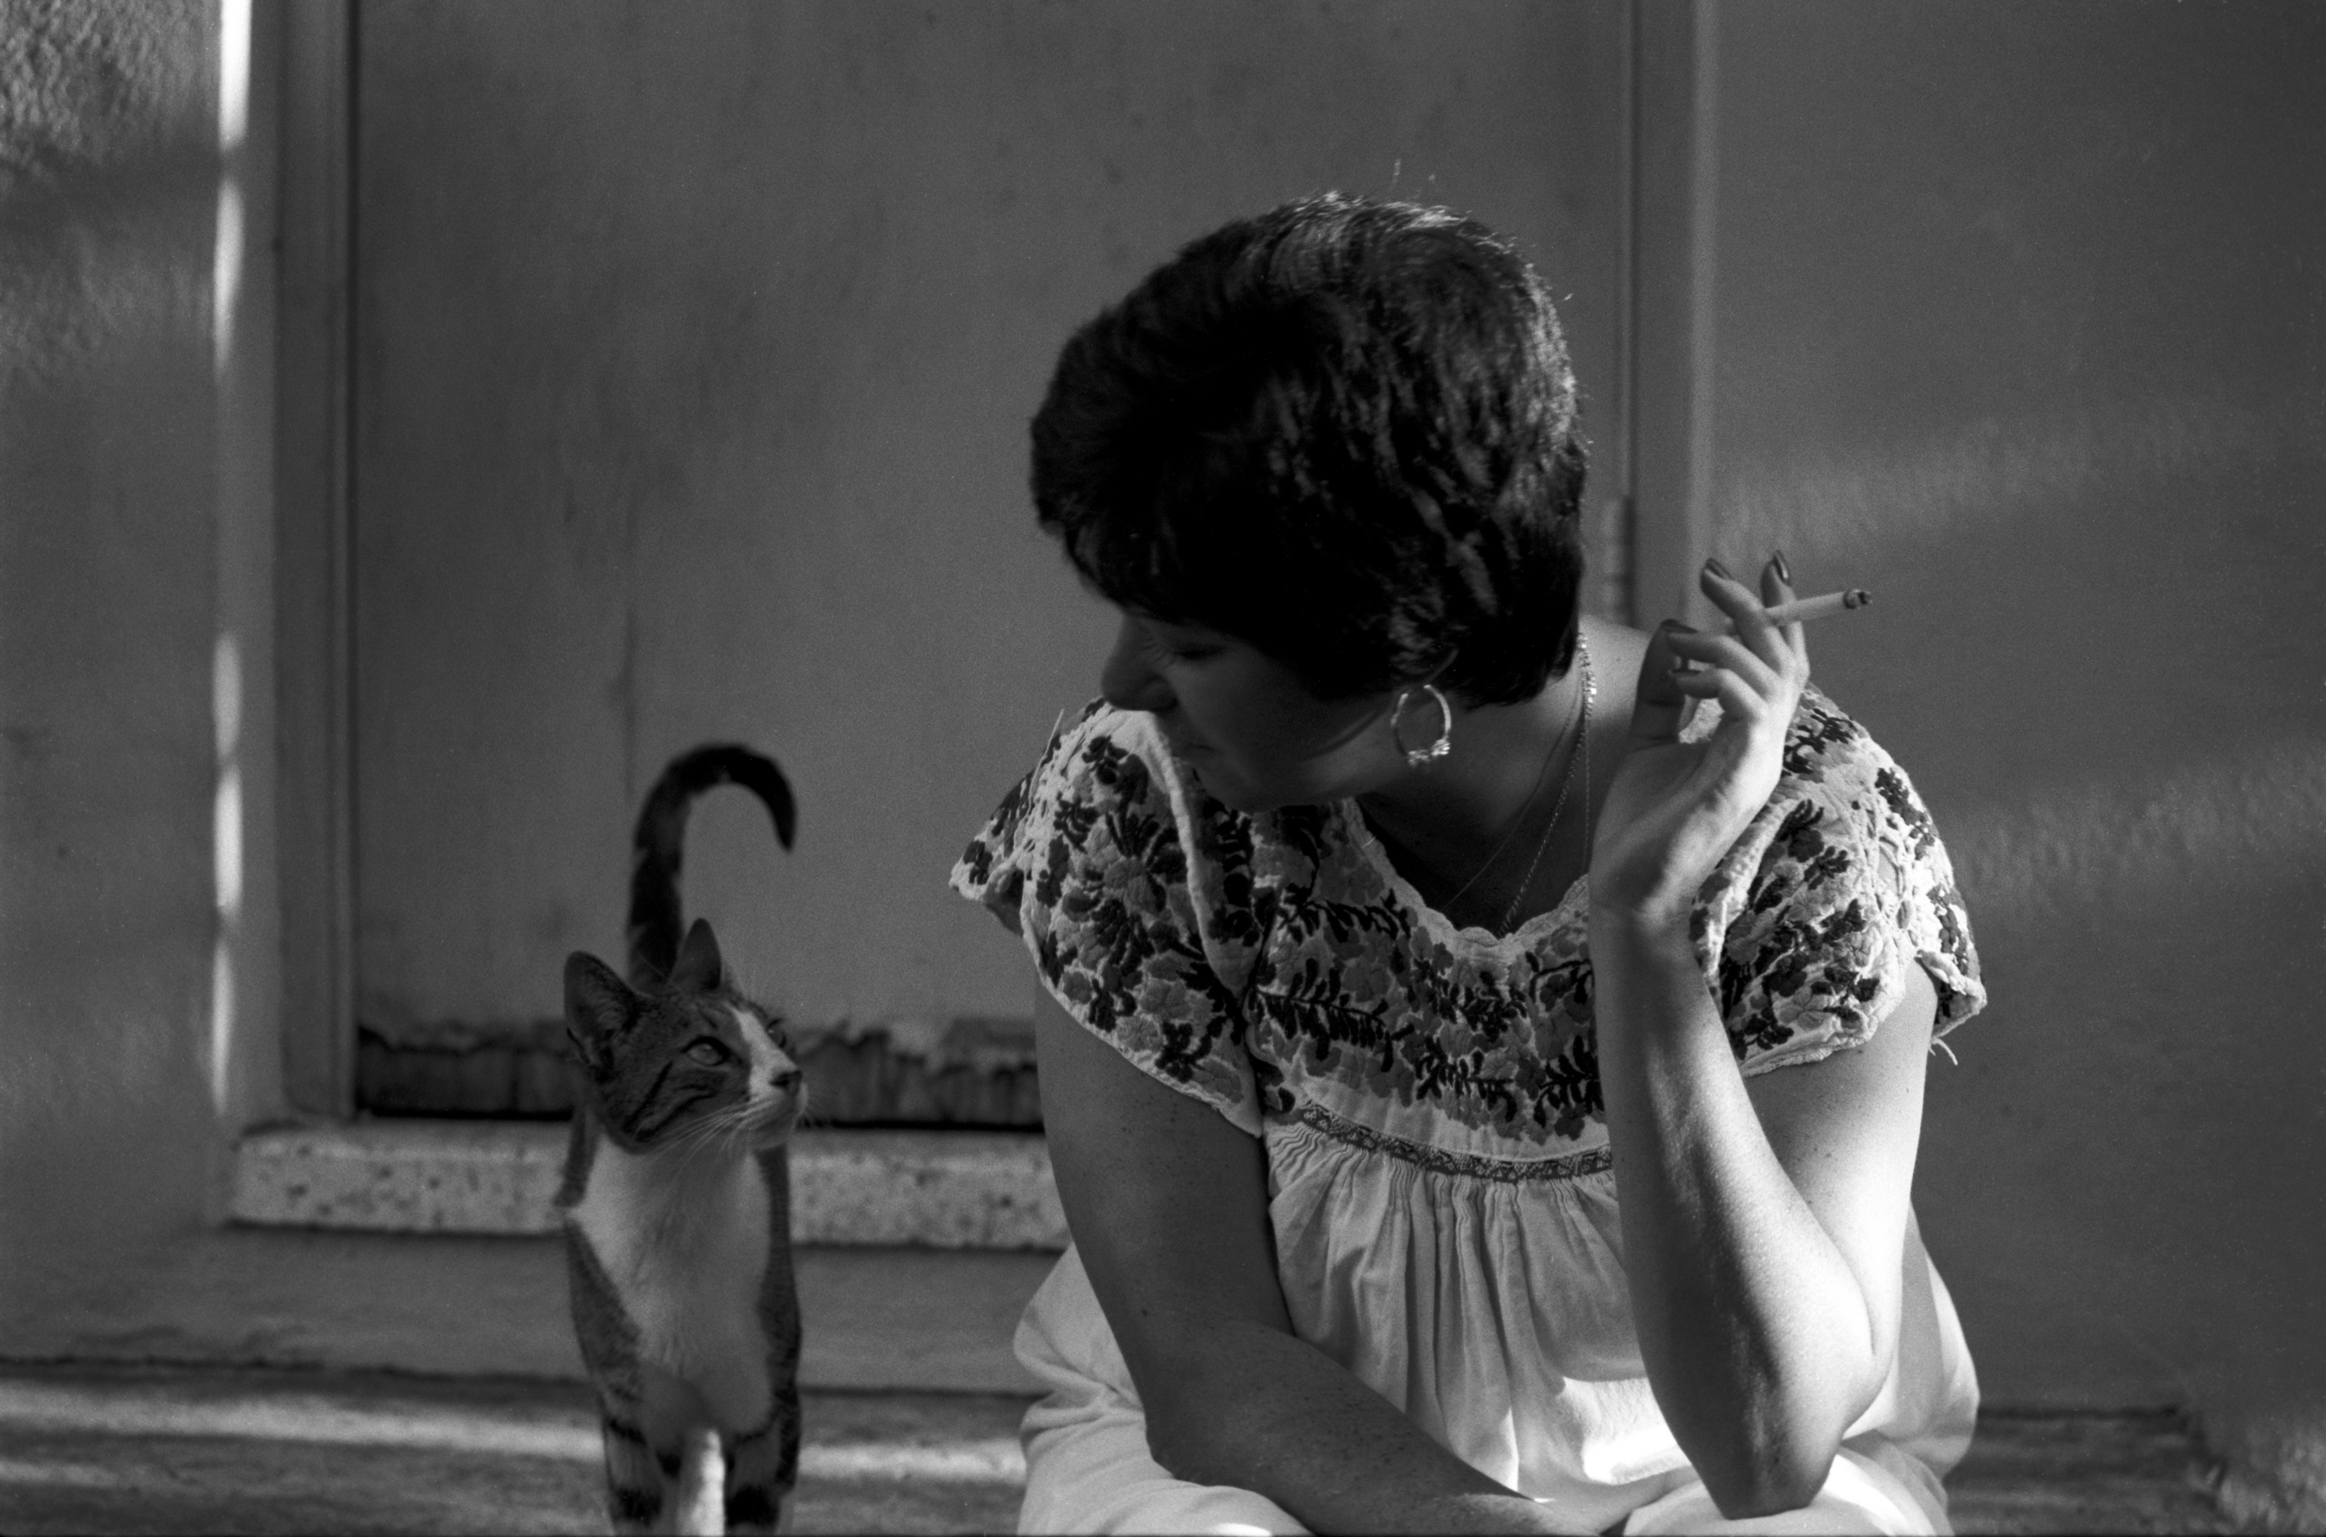
The following images were captured on film (except as noted)
Mind reading 1980
Notes:
1980 Panatomic X

Slide 2
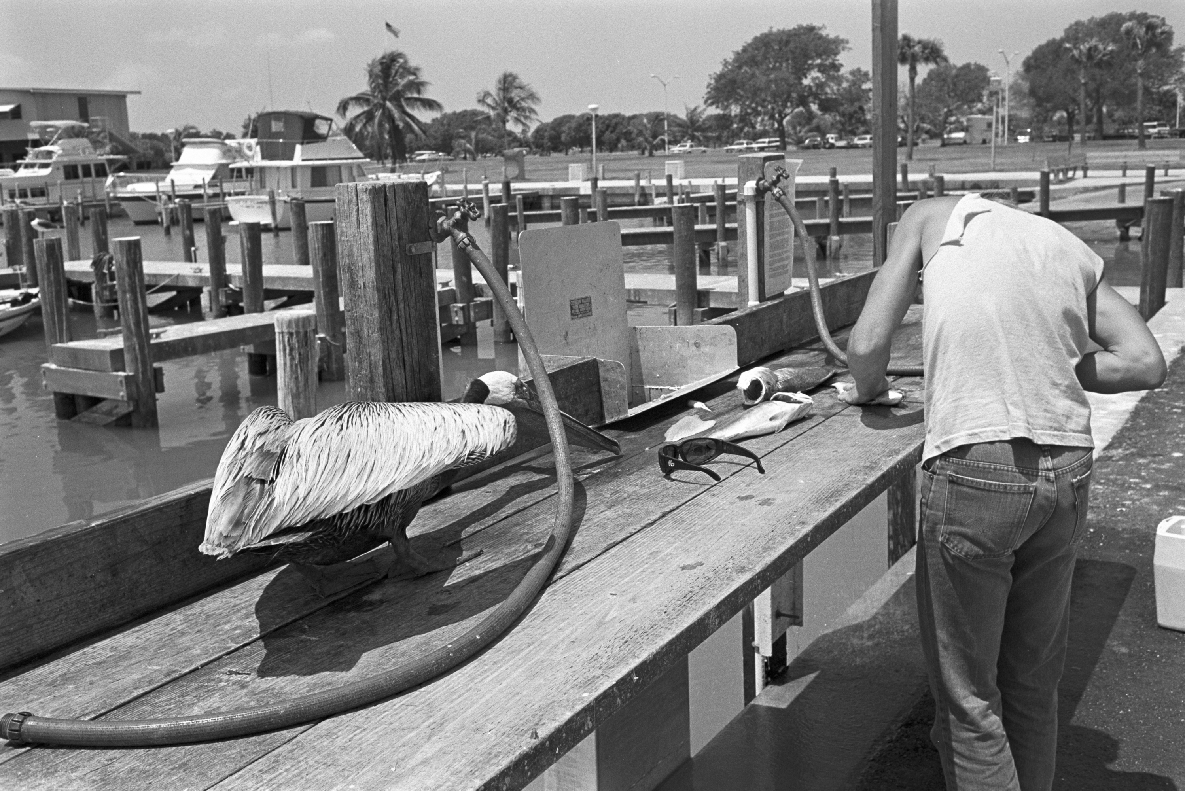
Flamingo Marina, Everglades National Park 1983
Notes:
1983 Plus X

Slide 3
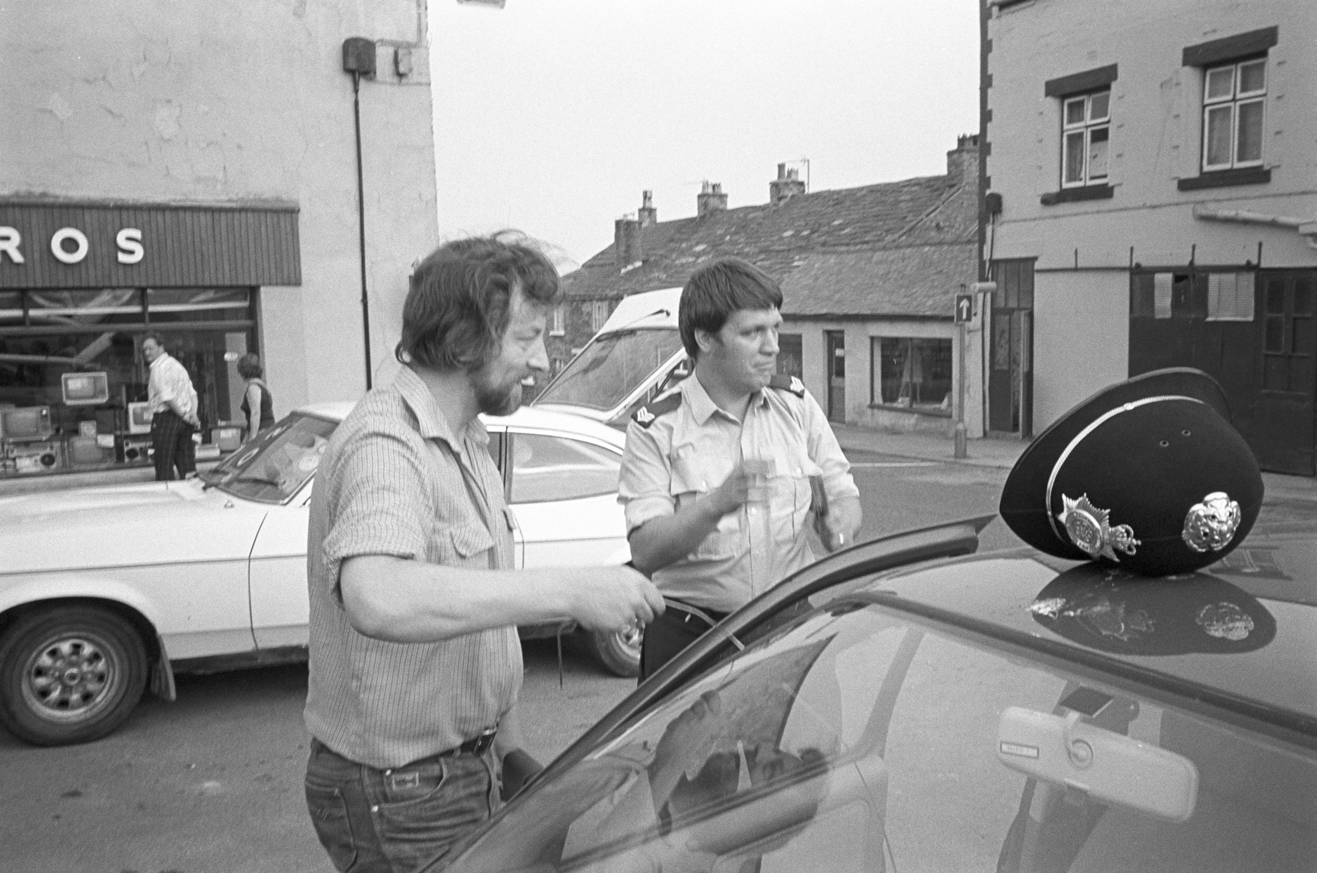
Super Sid’s legal break-in - Darrowby, Yorkshire 1983
Notes:
1983 Tri X

Slide 4
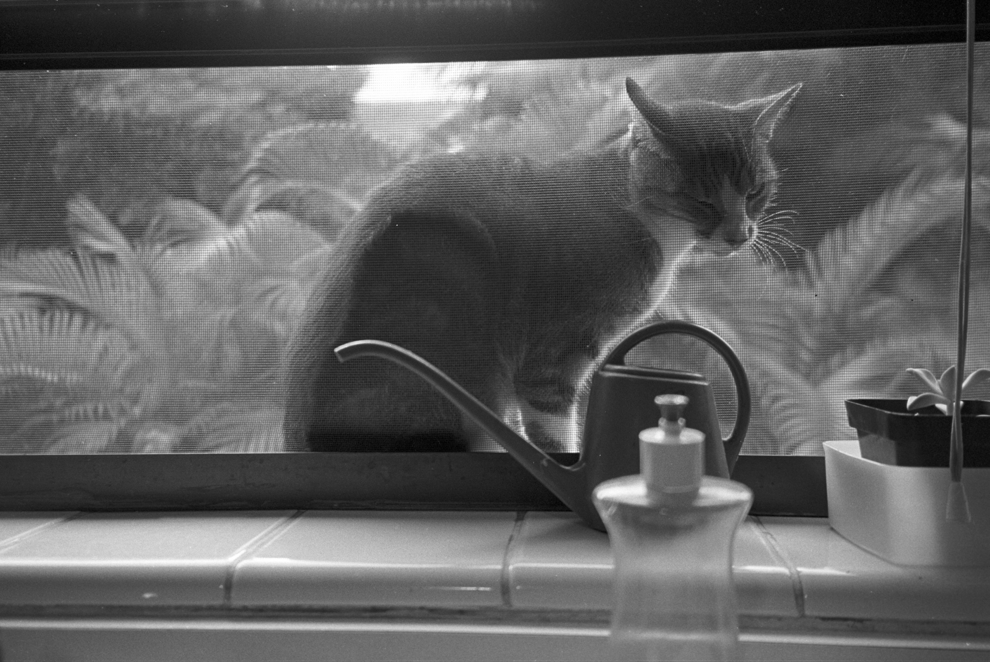
Tinkerbell 1983
Notes:
1983 Tri X

Slide 5
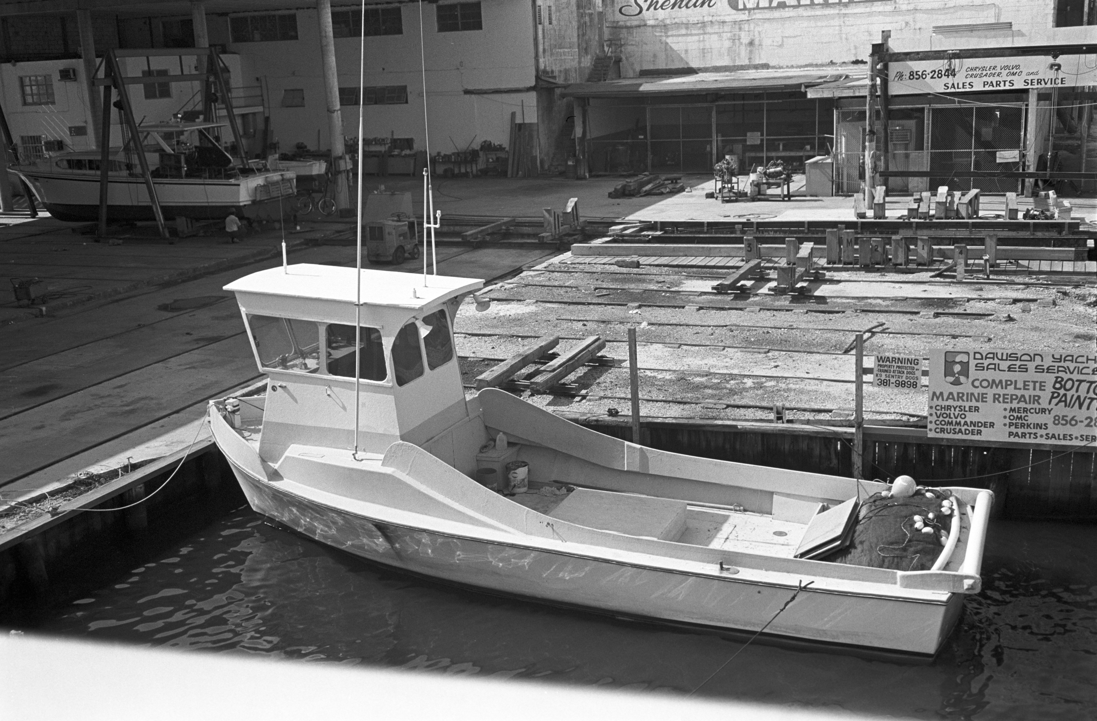
Miami River 1983
Notes:
1983 Plus X

Slide 6
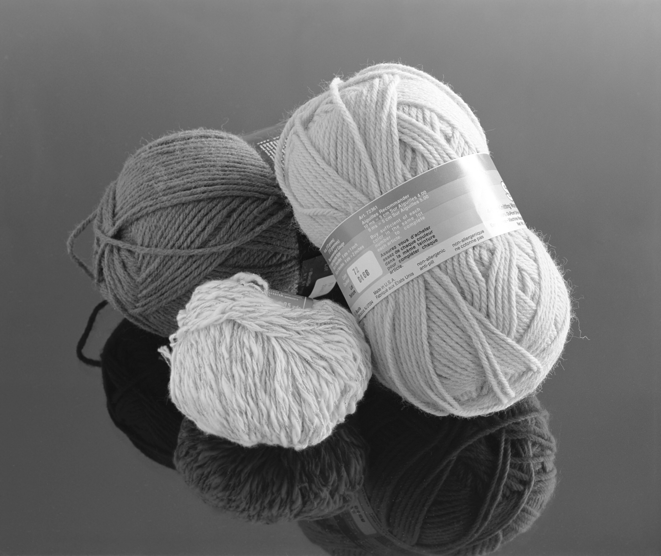
Yarn 1984
Notes:
1984 RB67 Plus X

Slide 7
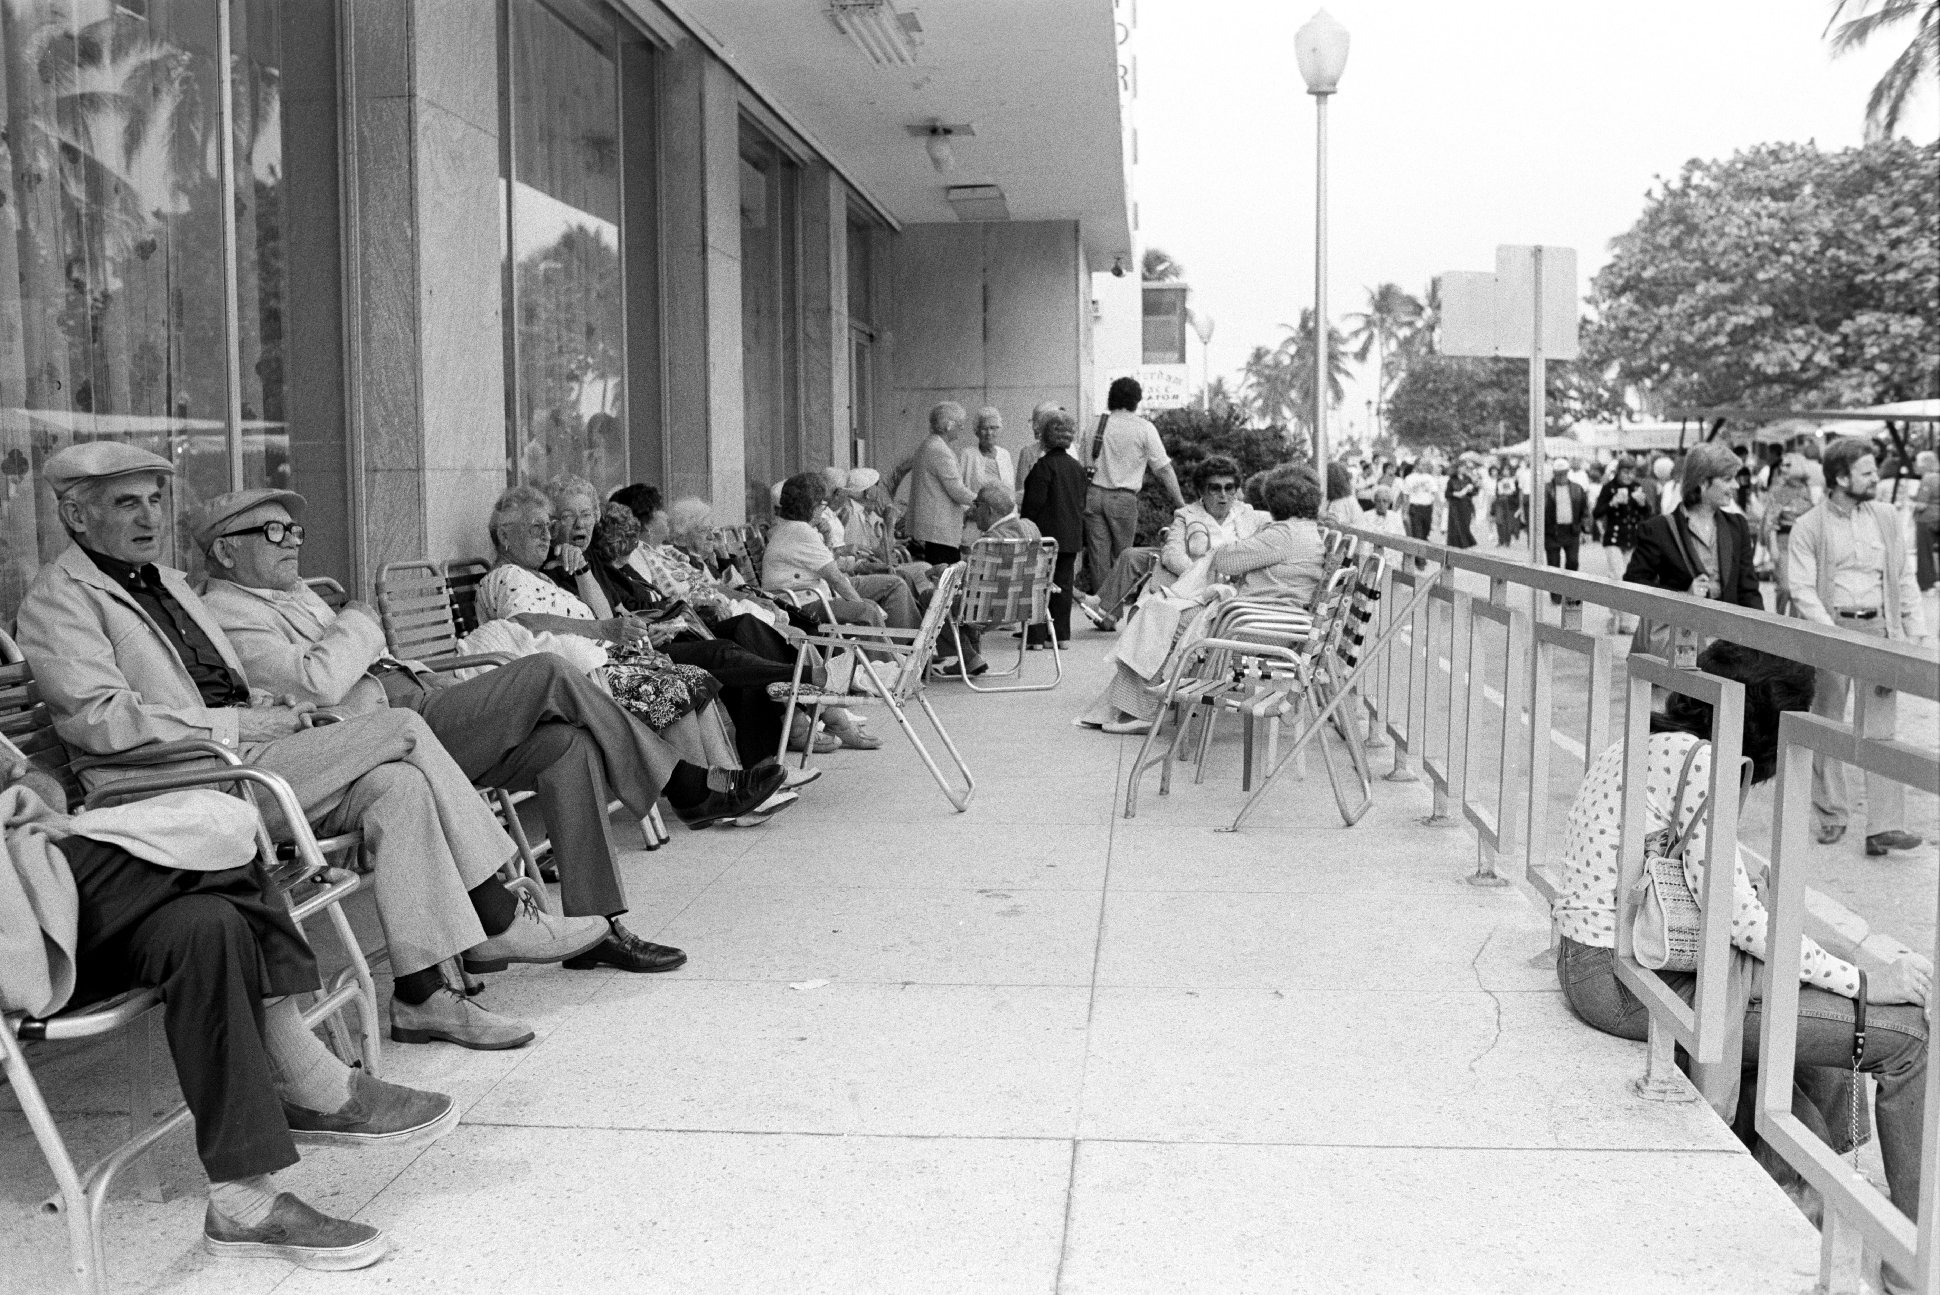
South Beach 1984
Notes:
1984 Panatomic X

Slide 8
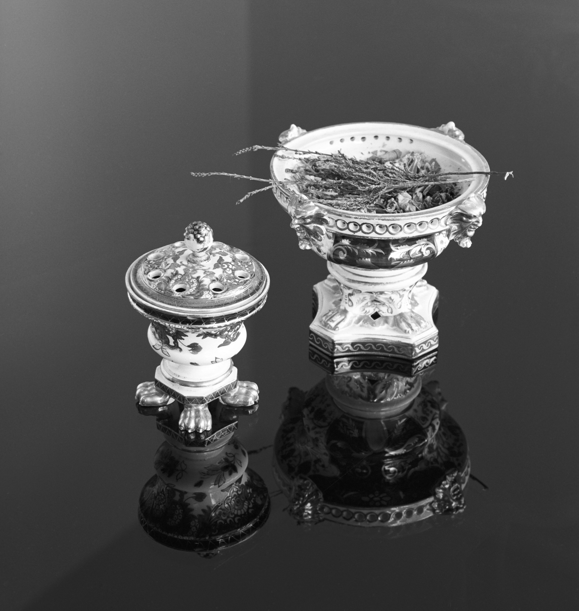
Incense holders 1984
Notes:
1984 RB67 Plus X

Slide 9
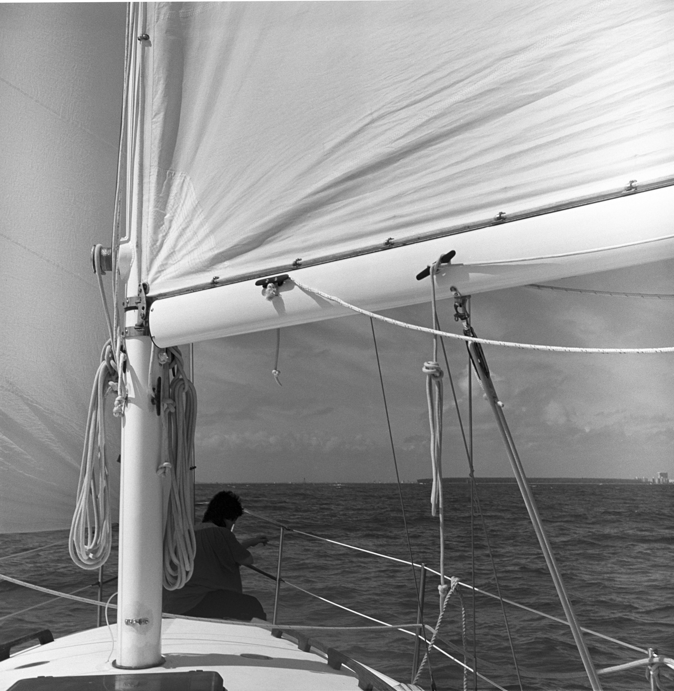
Biscayne Bay 1984
Notes:
1984 Yashicamat Tri X

Slide 10
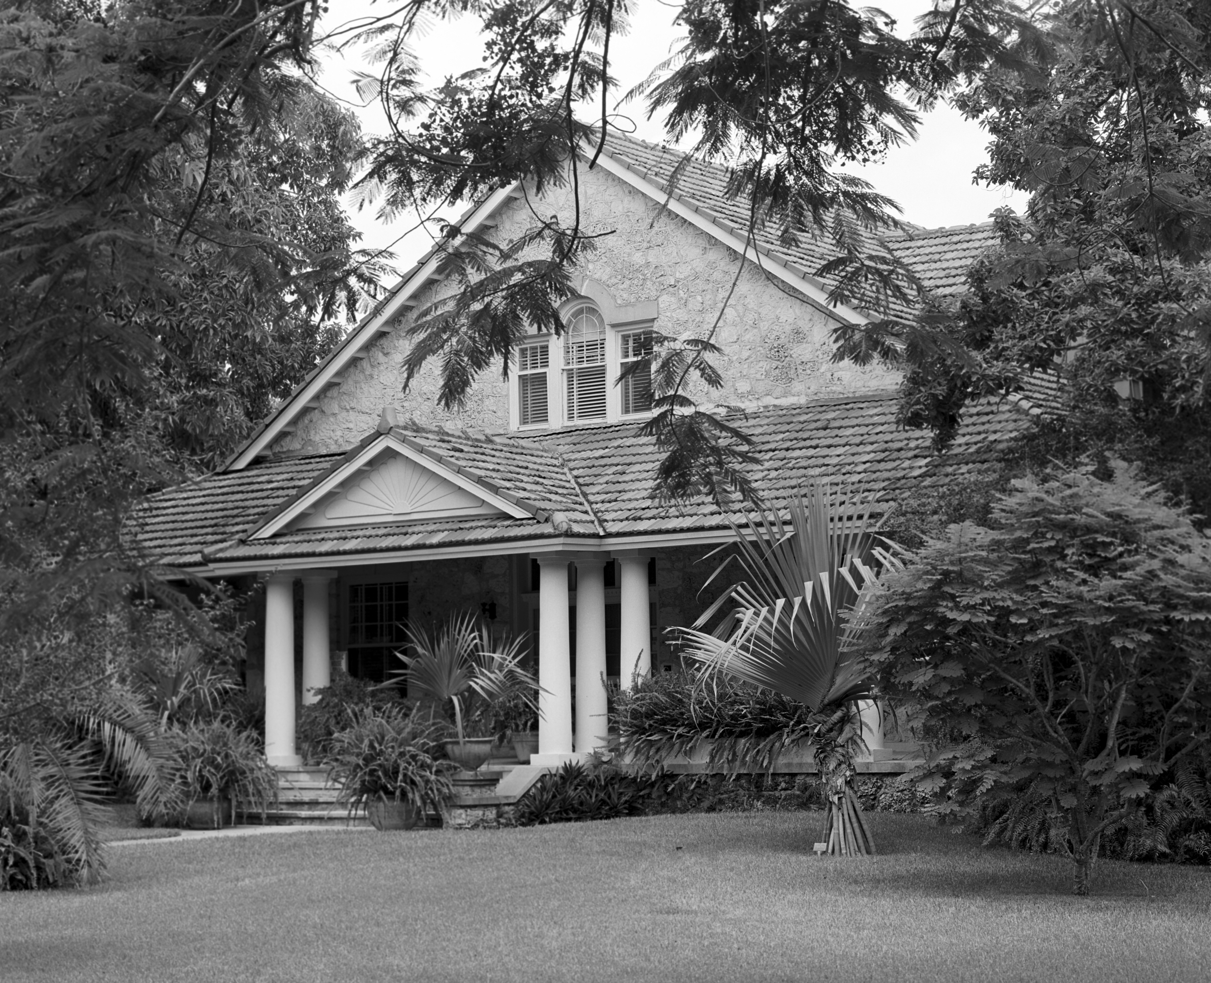
Merrick House, Coral Gables 1984
Notes:
1984 RB67 Plus X

Slide 11
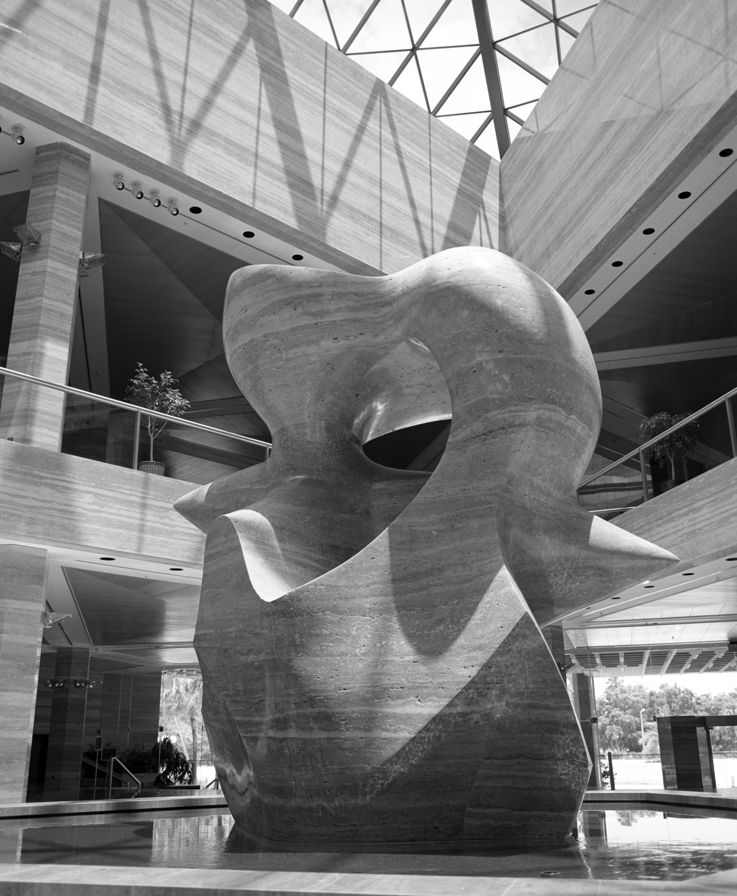
Henry Moore Sculpture, InterContinental Hotel 1984
Notes:
1984 RB67 Plus X

Slide 12
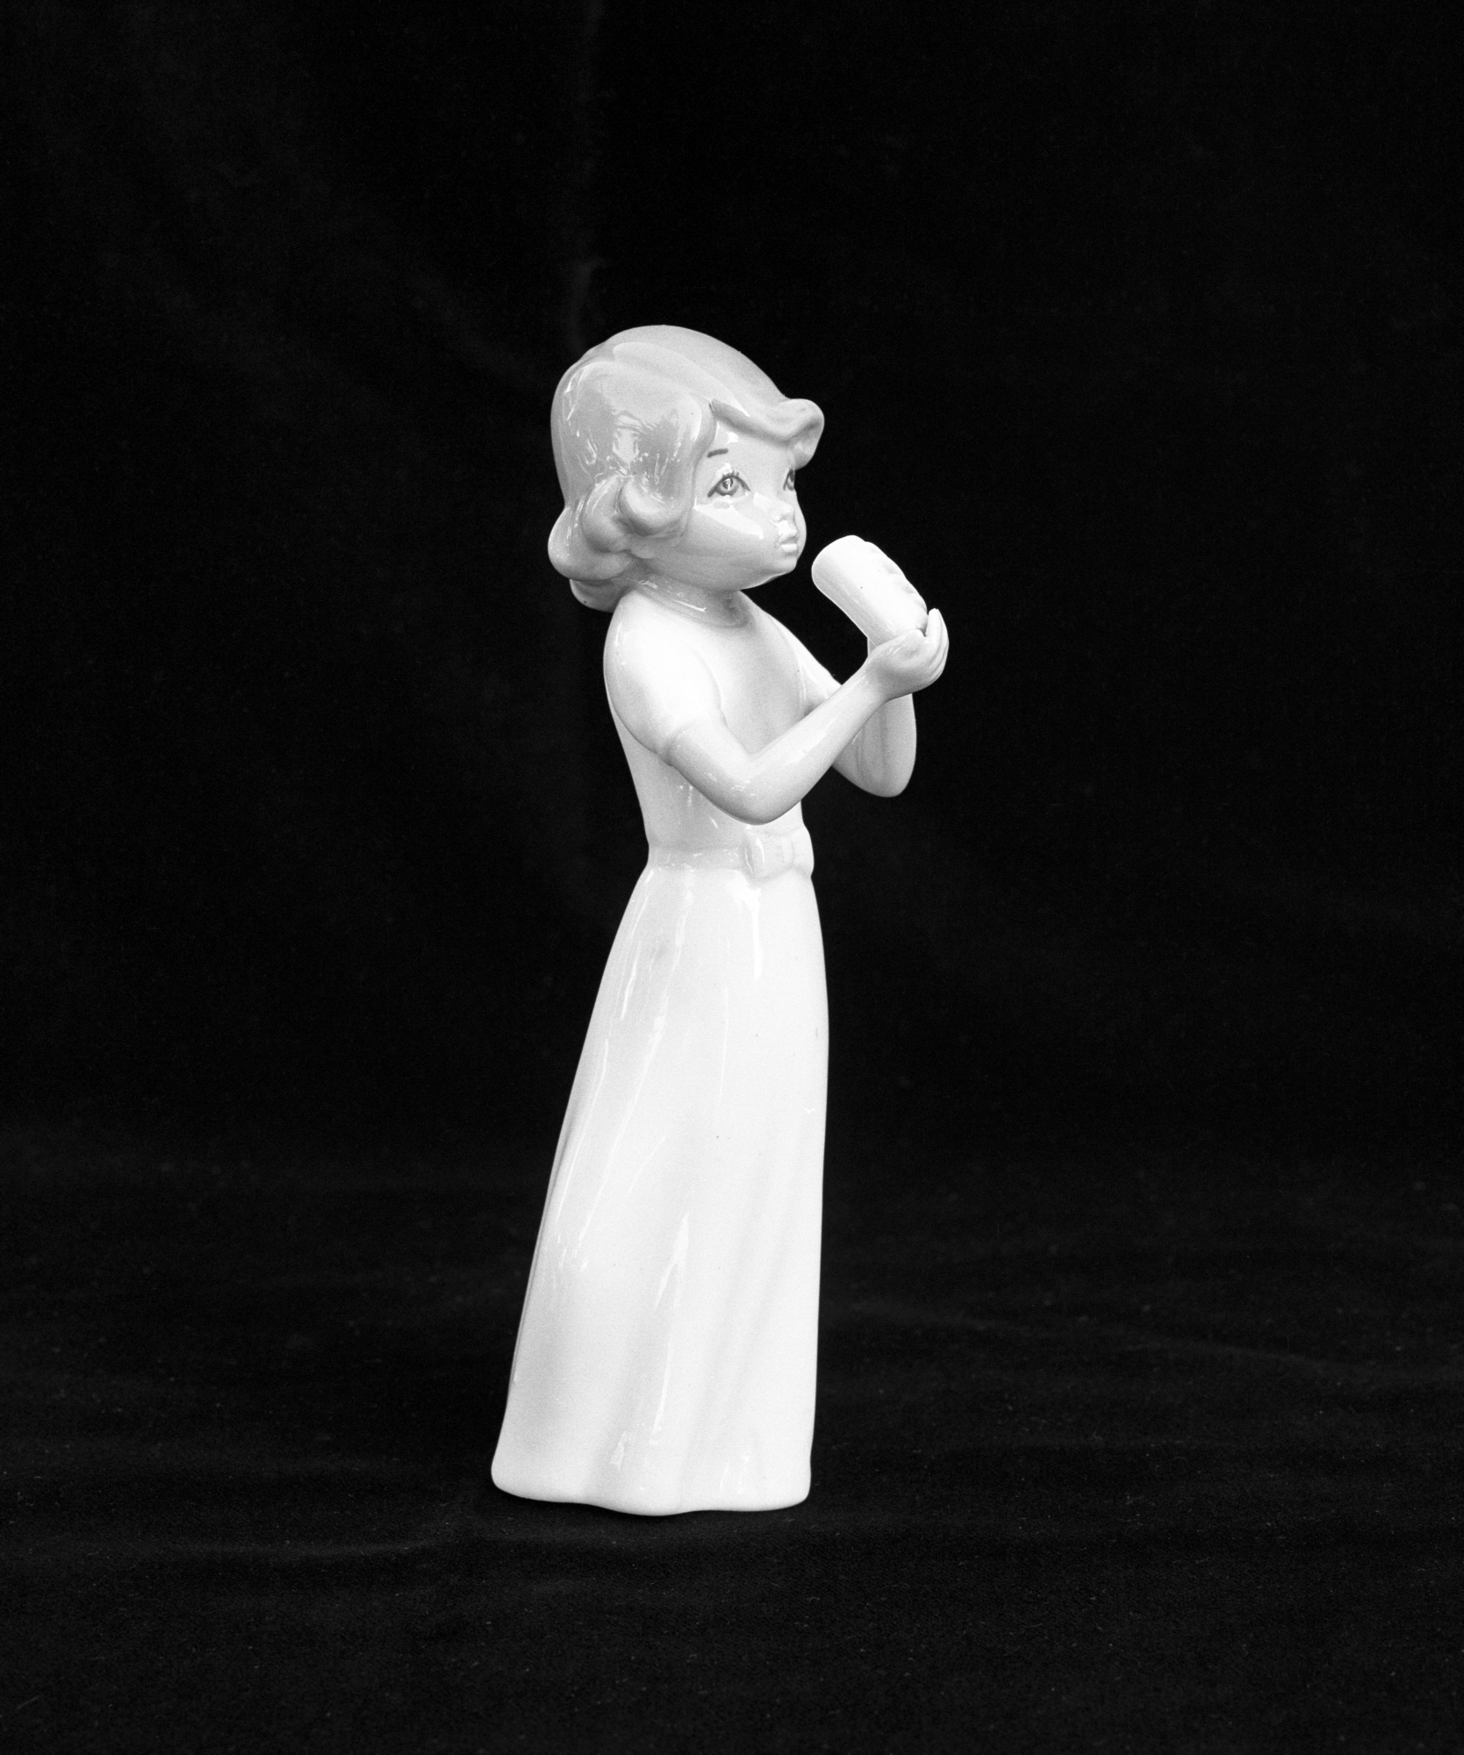
Lladro figurine 1984
Notes:
1984 RB67 Tri X

Slide 13
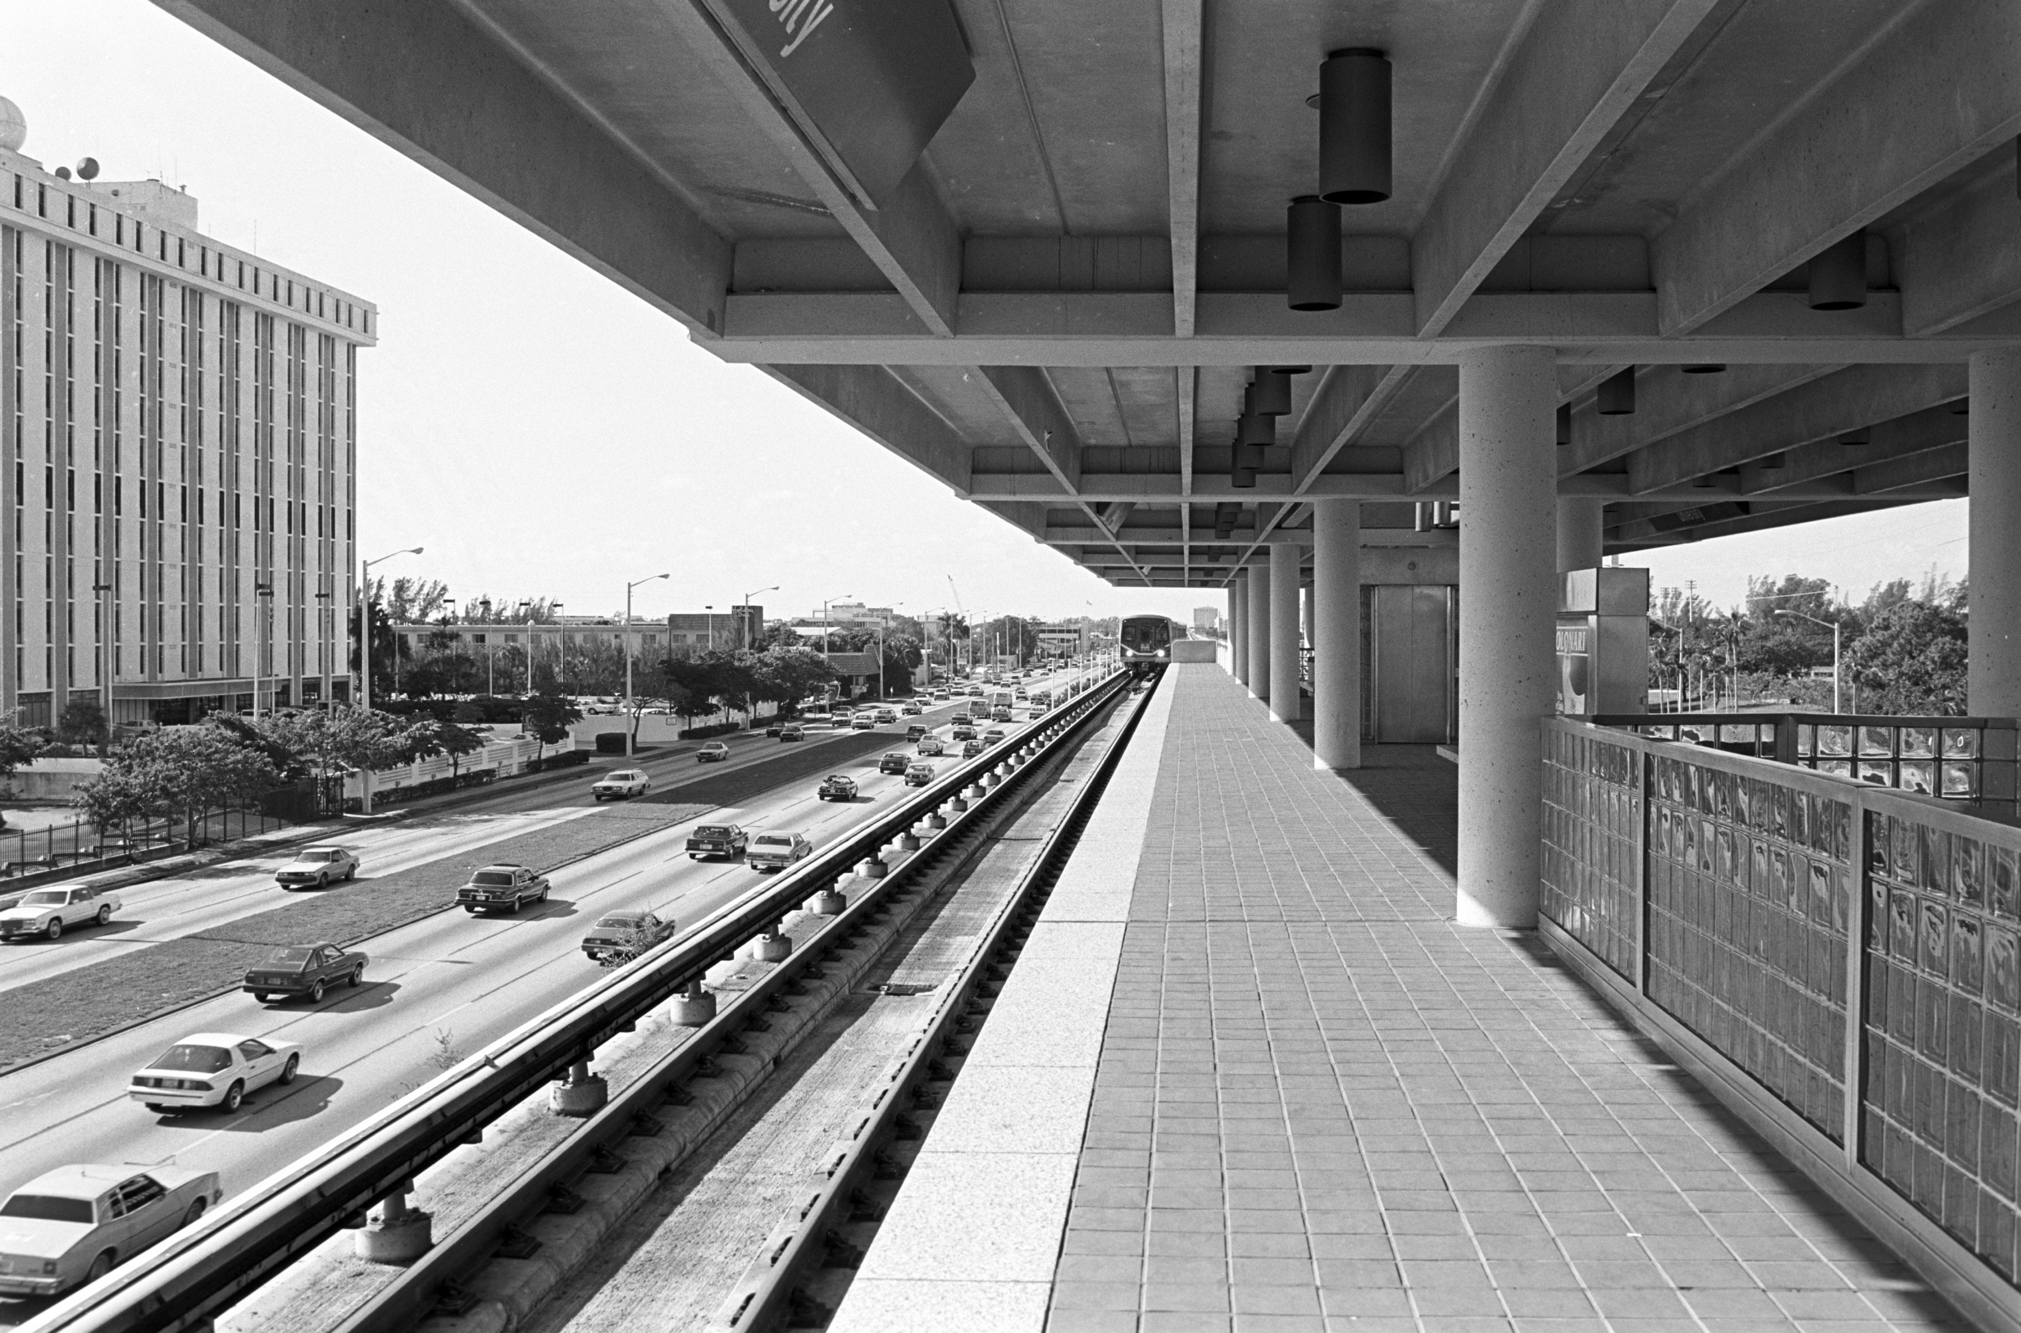
Metrorail Station, Coral Gables 1984
Notes:
1984 Plus X

Slide 14
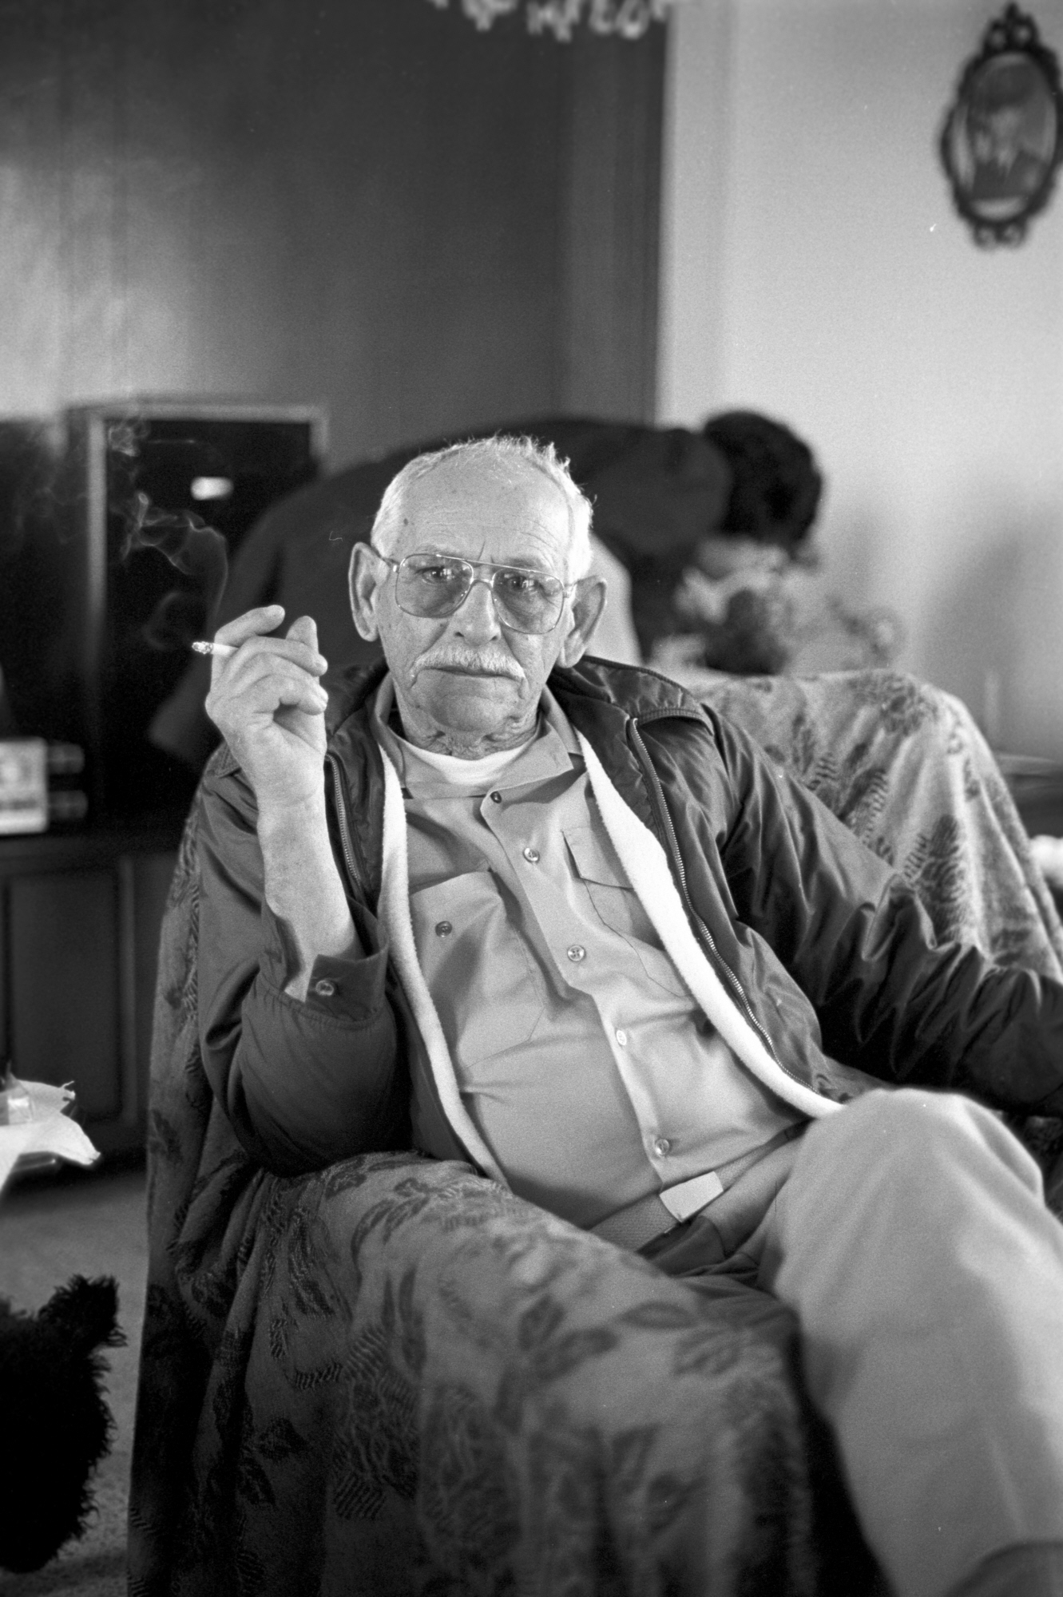
Antonio Quintas 1985
Notes:
1985 Tri X

Slide 15
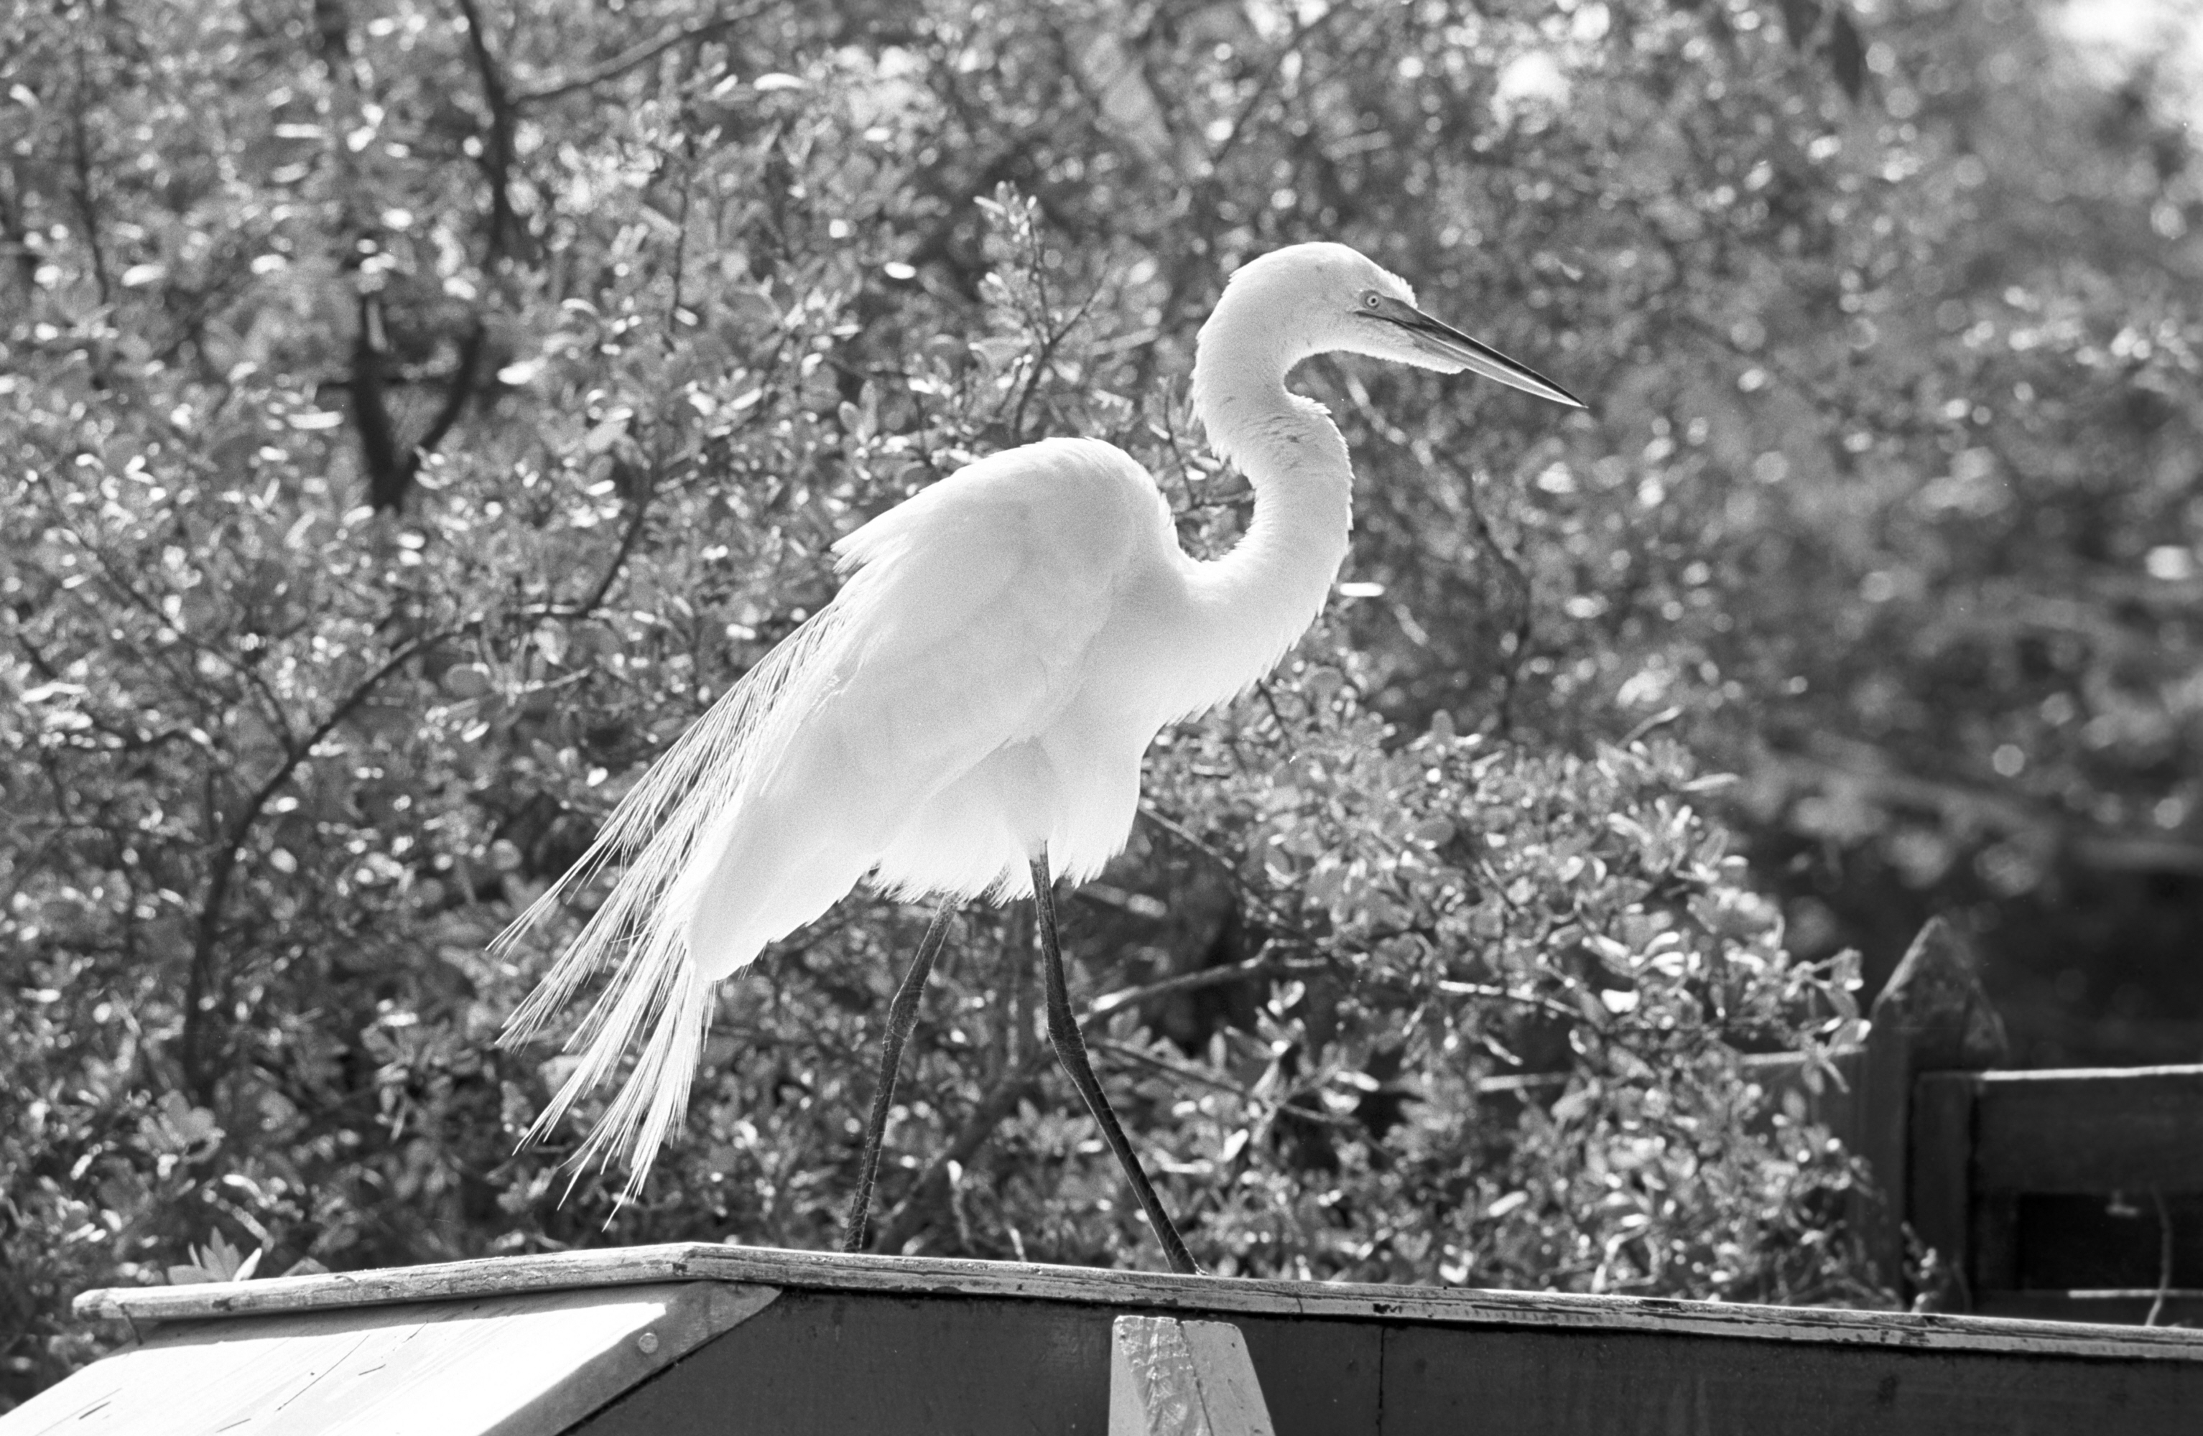
Theater of the Sea, Islamorada 1985
Notes:
1985 FP4

Slide 16
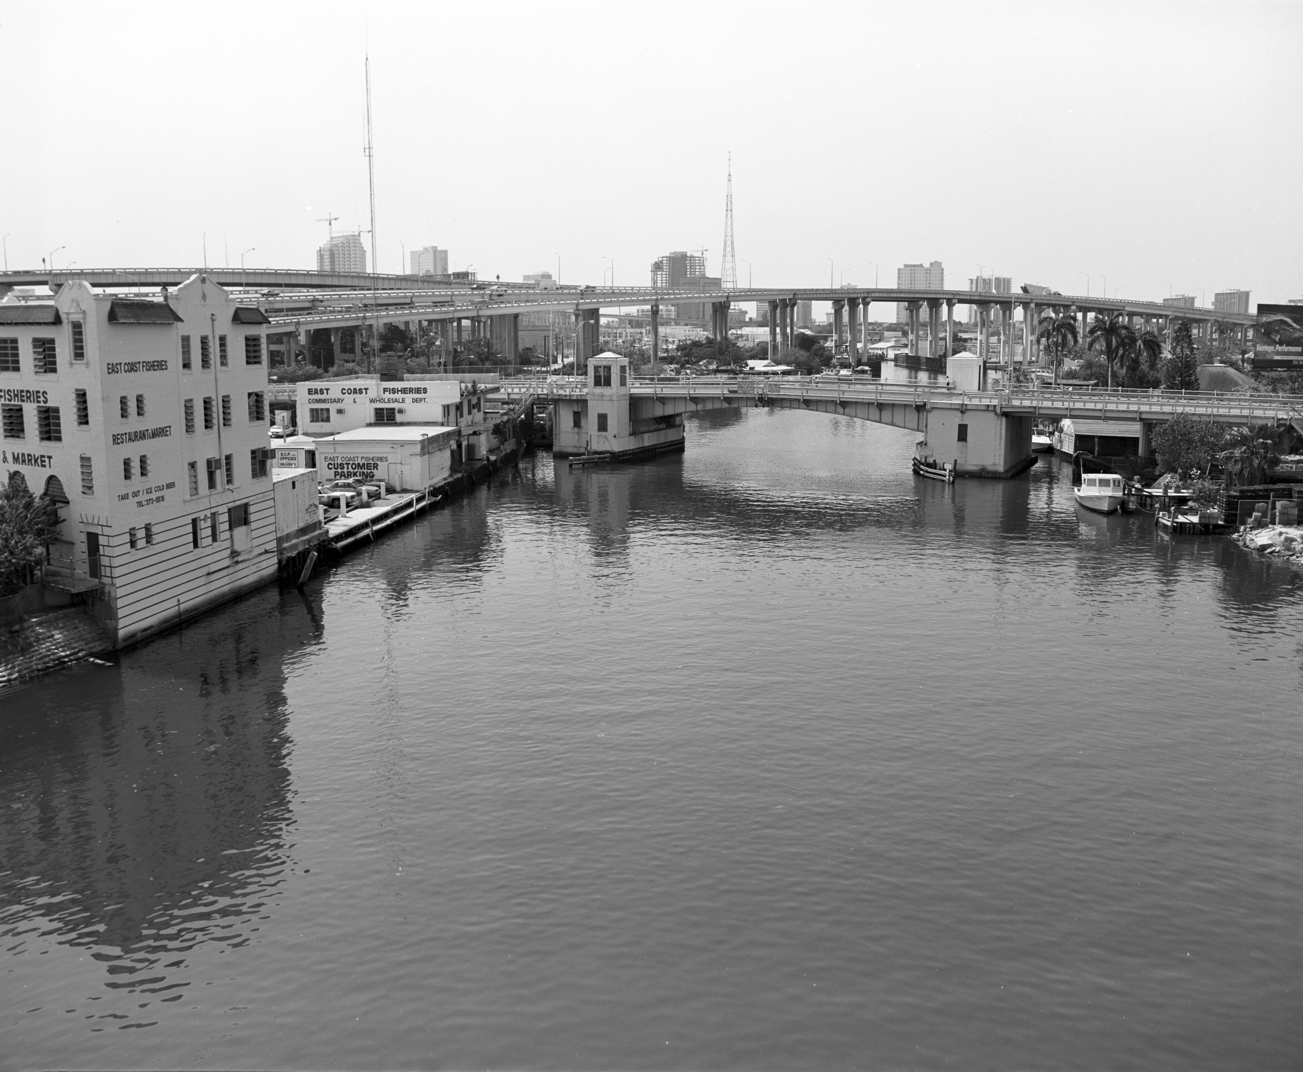
Miami River 1985
Notes:
1985 RB67 Panatomic X

Slide 17
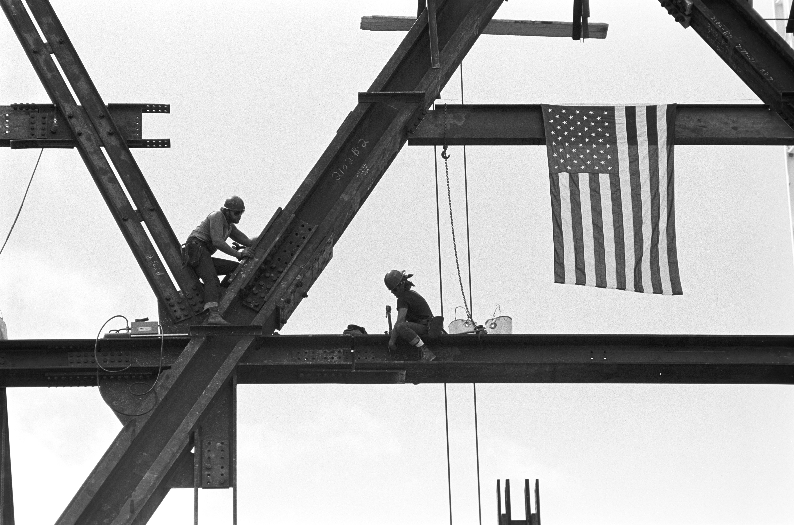
Coral Gables 1985
Notes:
1985 FP4

Slide 18
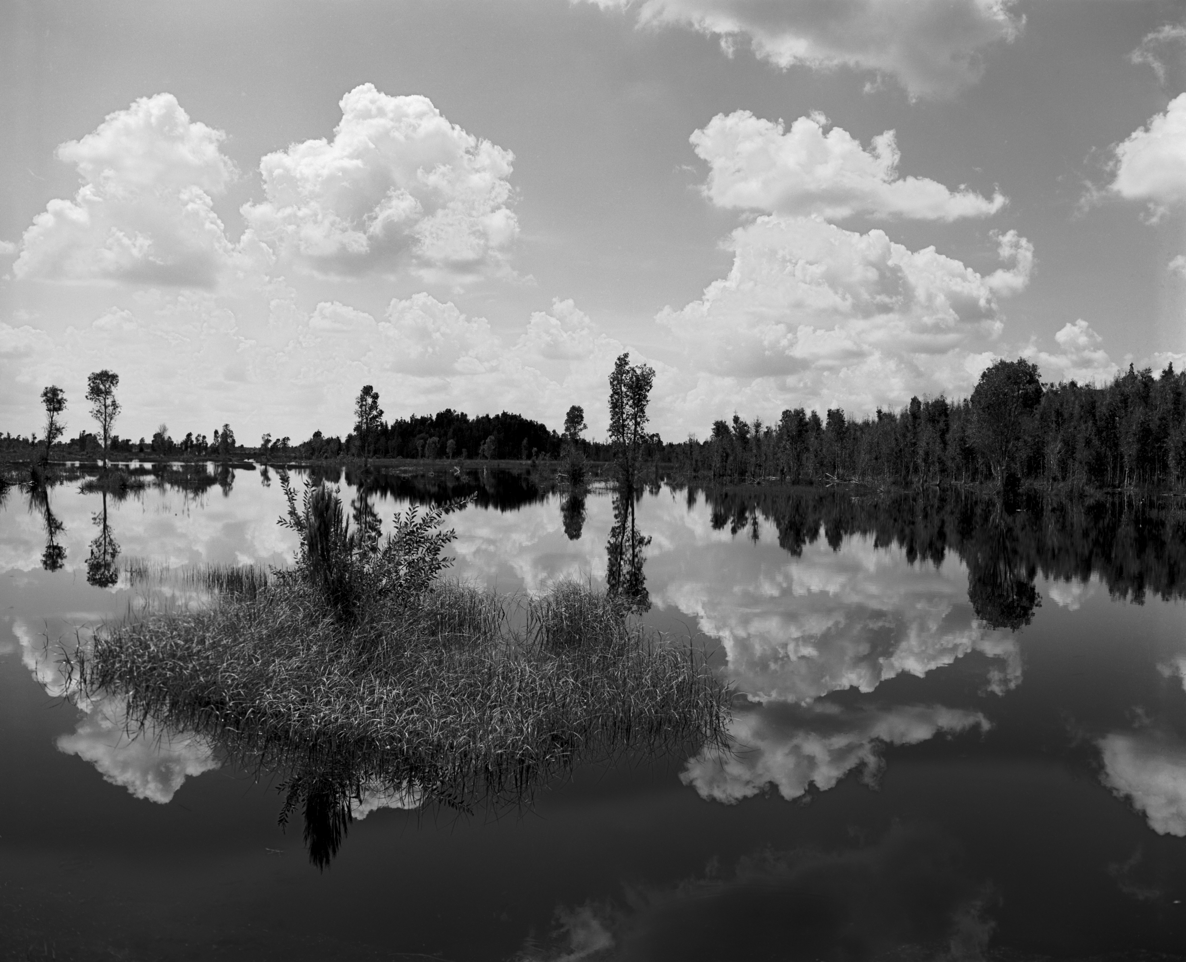
Everglades 1985
Notes:
1985 RB67 Agfa 25

Slide 19
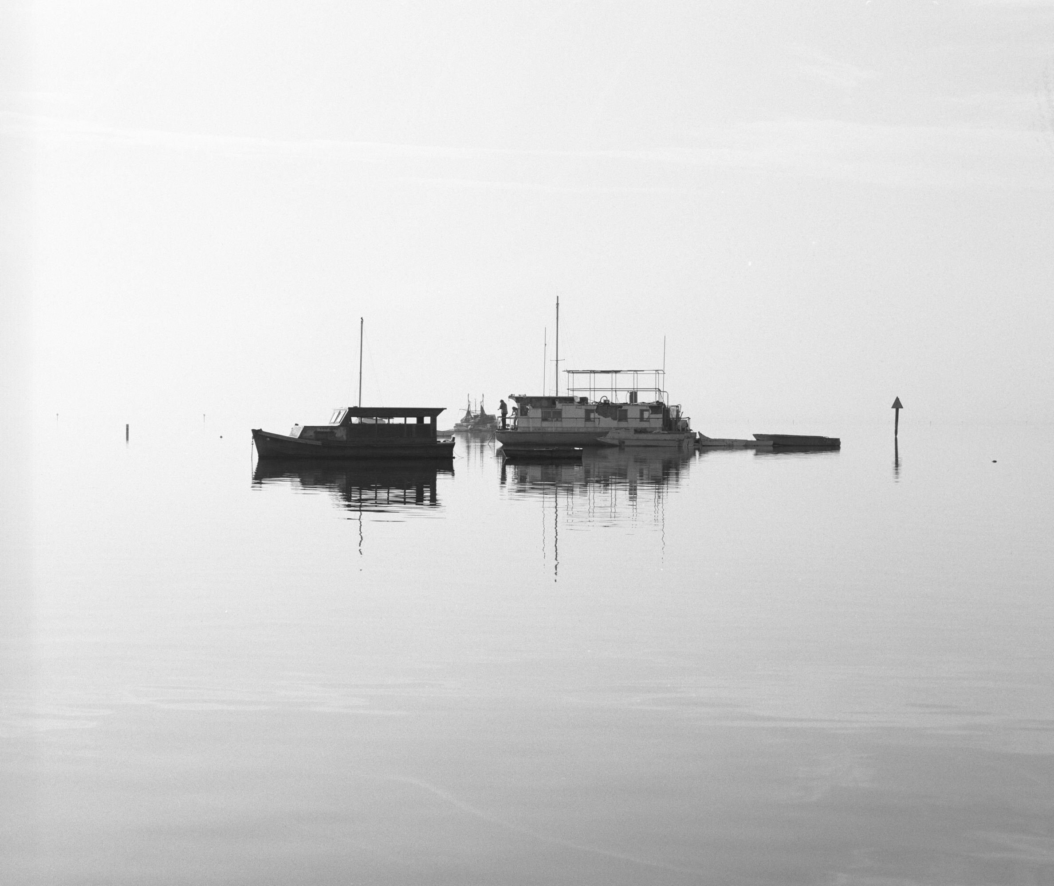
Coconut Grove 1986
Notes:
1986 RB67 FP4

Slide 20
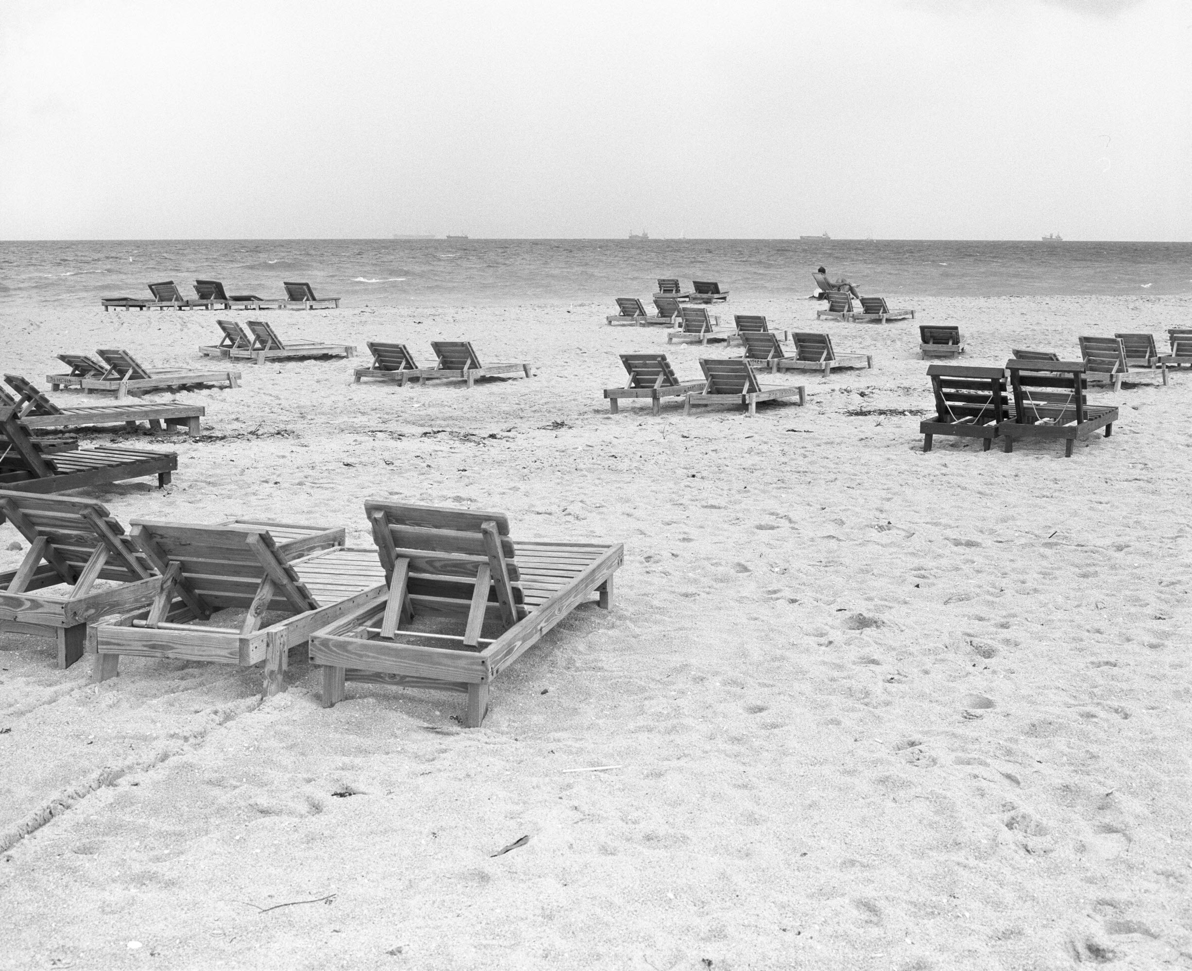
Miami Beach 1986
Notes:
1986 RB7 HP5

Slide 21
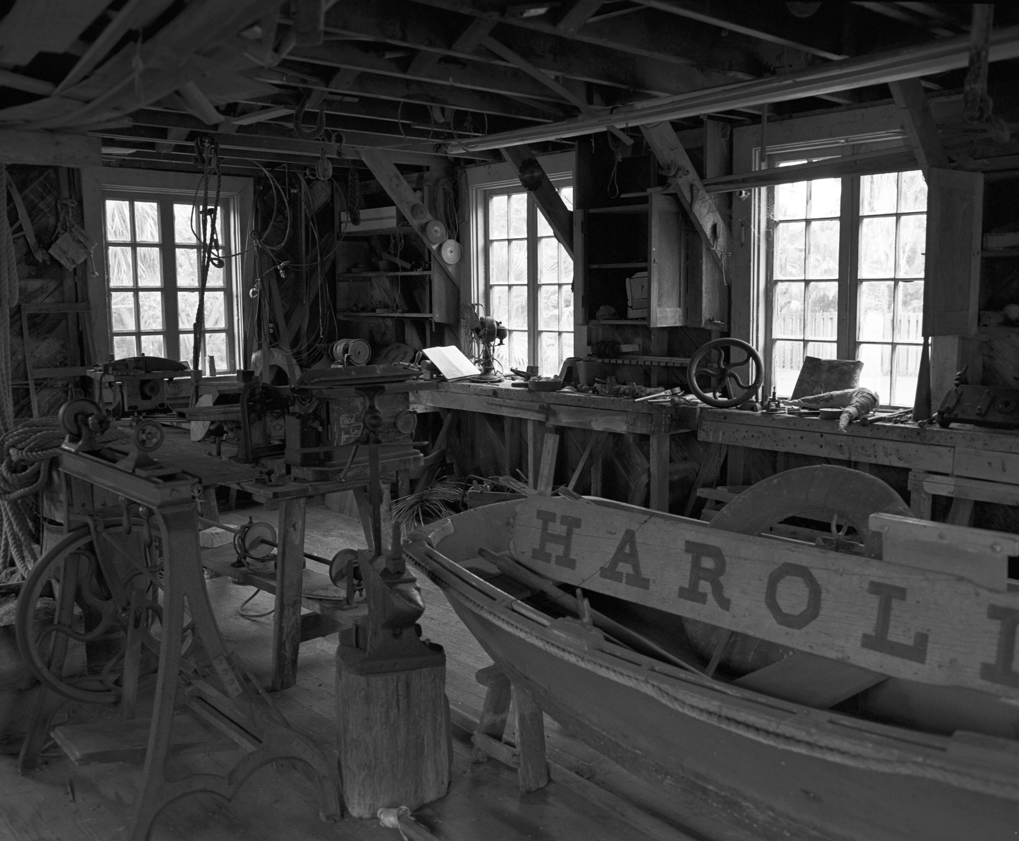
The Barnacle, Coconut Grove 1986
Notes:
1986 RB67 Tri X

Slide 22
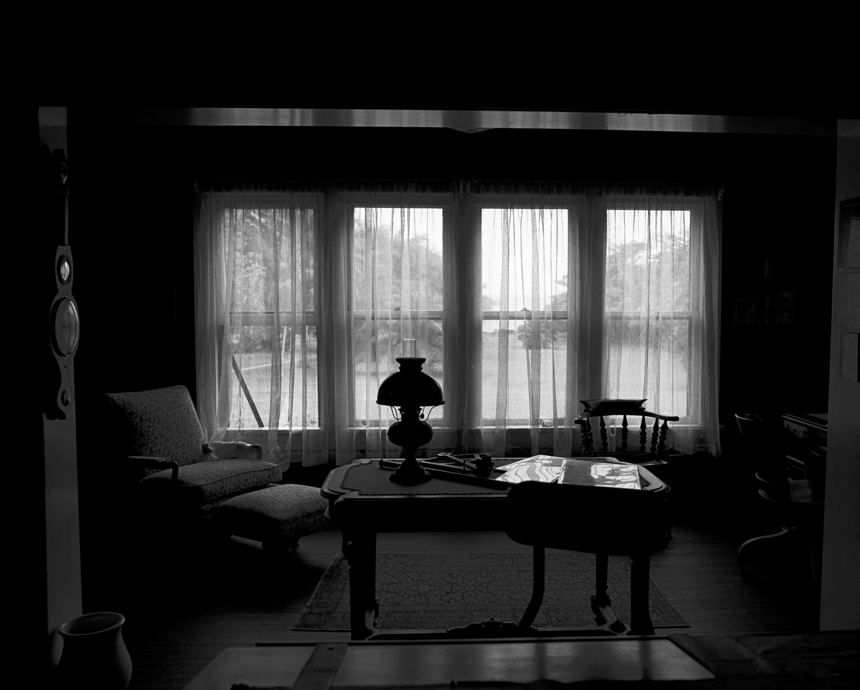
The Barnacle, Coconut Grove 1986
Notes:
1986 RB67 Tri X

Slide 23
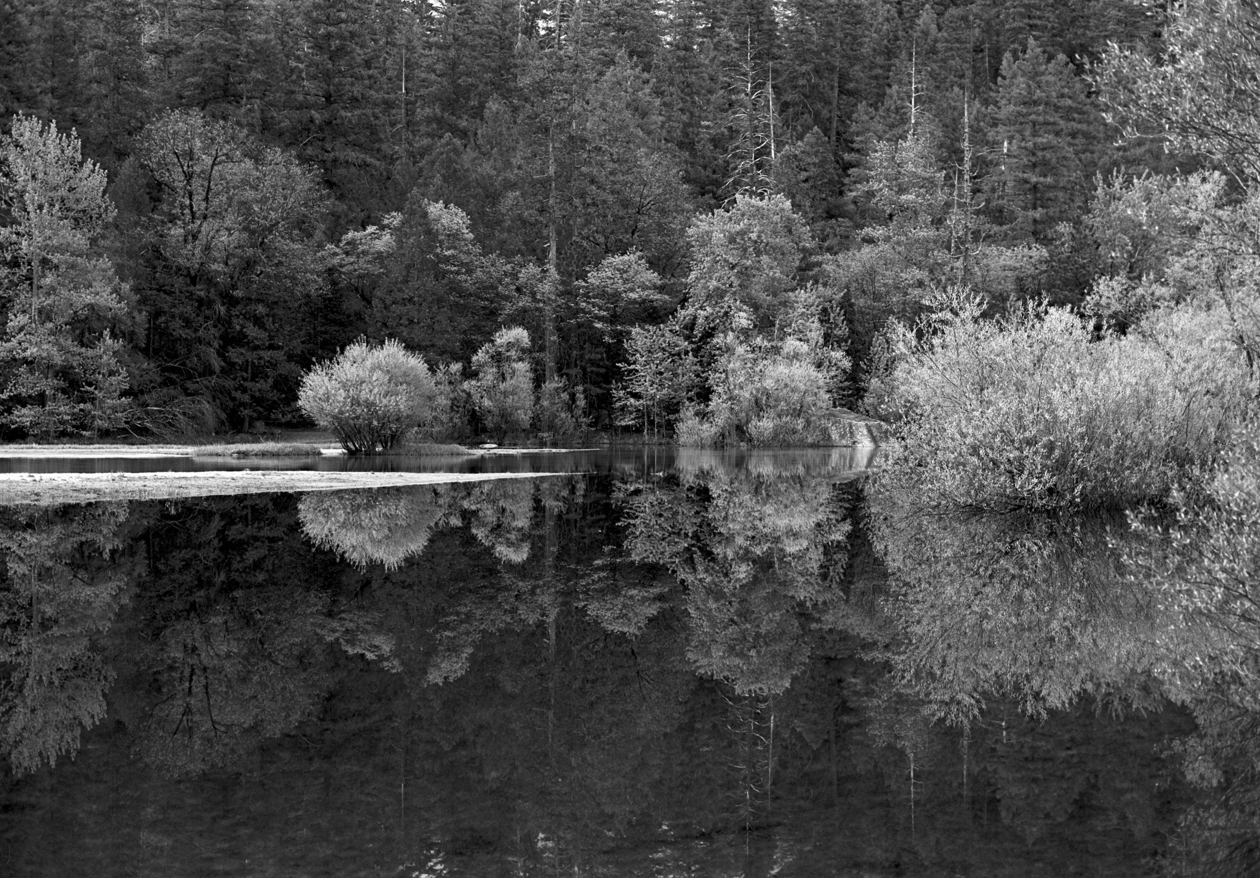
Mirror Lake, Yosemite 1986
Notes:
1986 Agfa 25

Slide 24
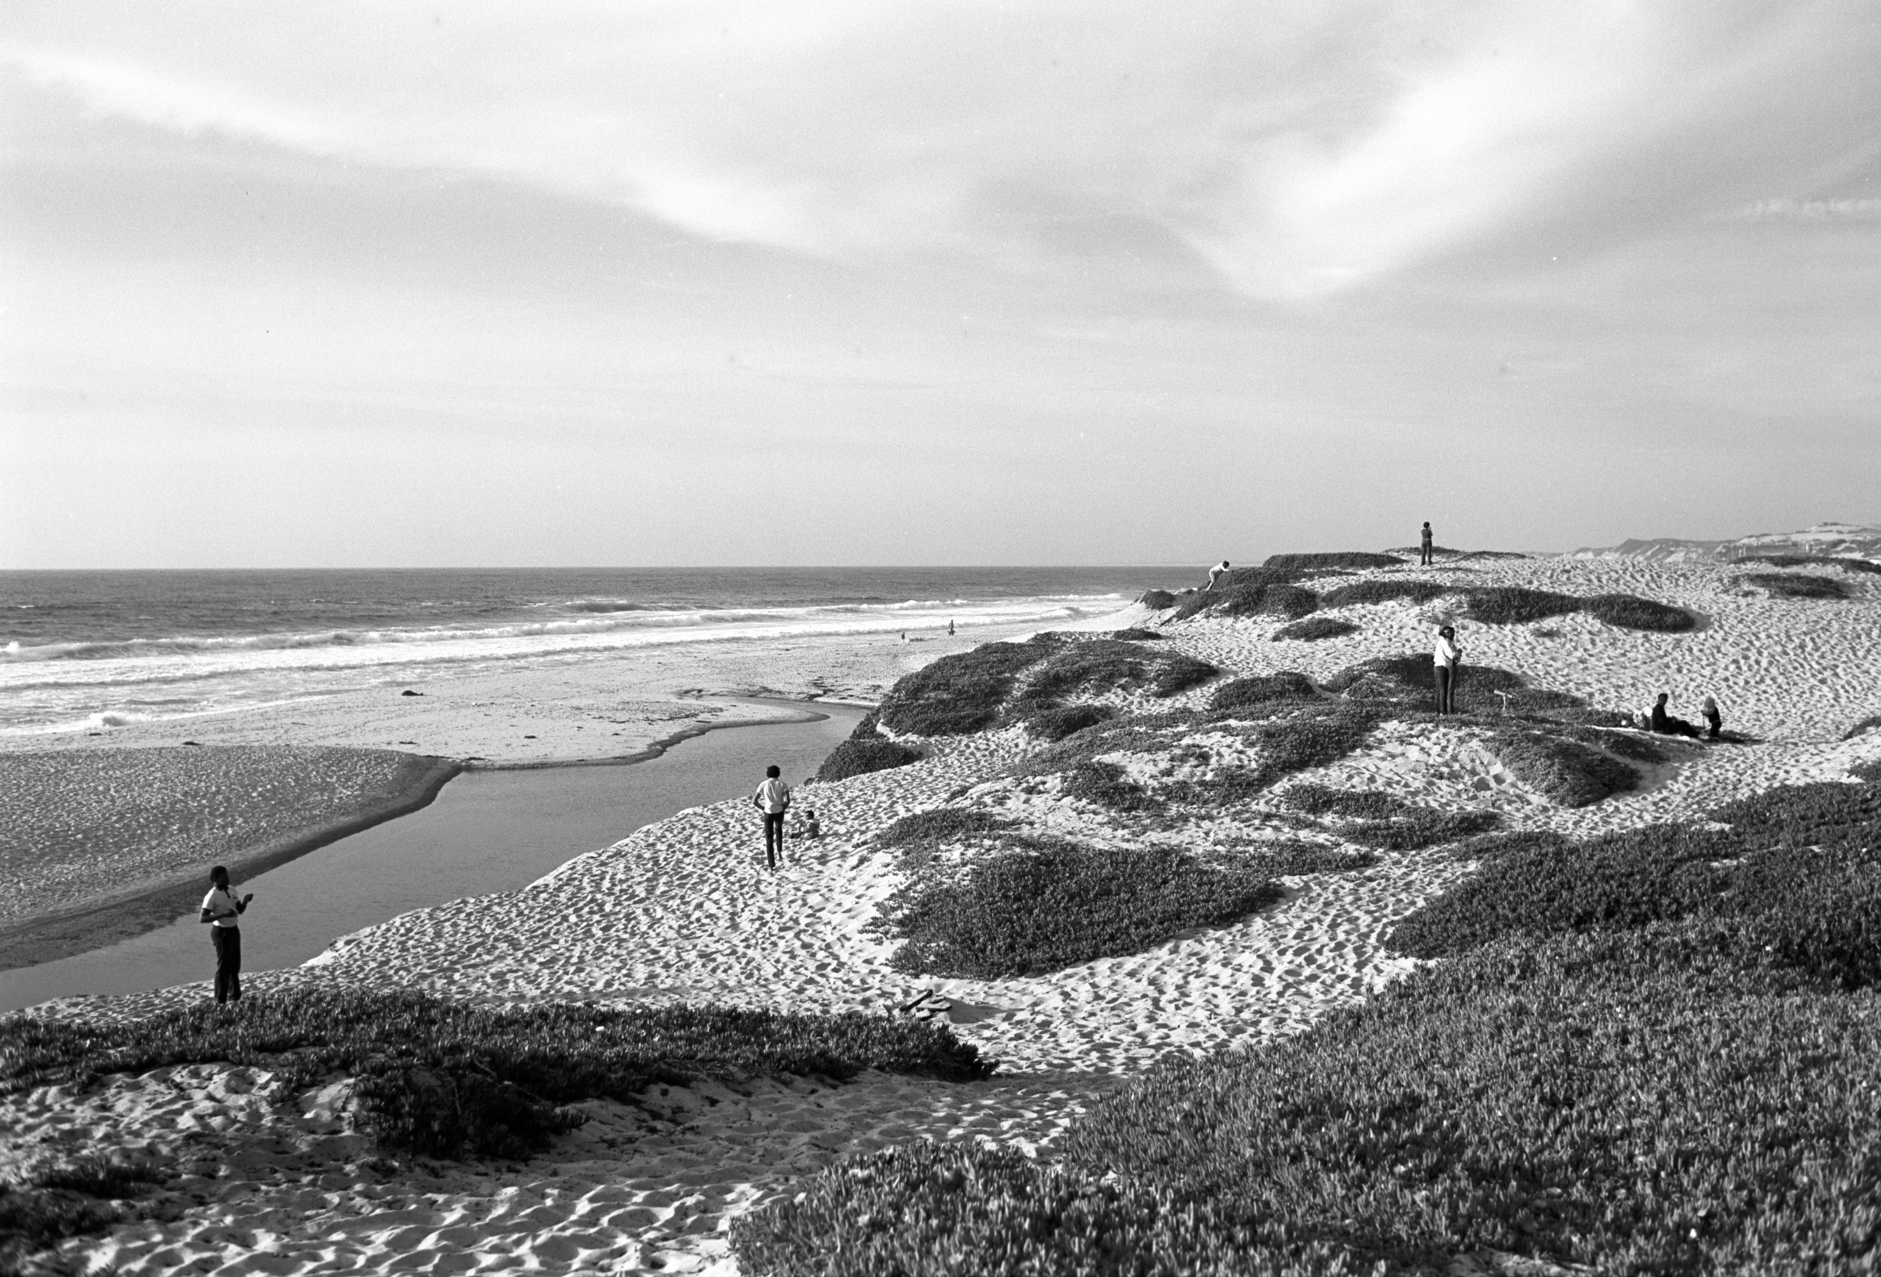
Monterey 1986
Notes:
1986 Agfa 25

Slide 25
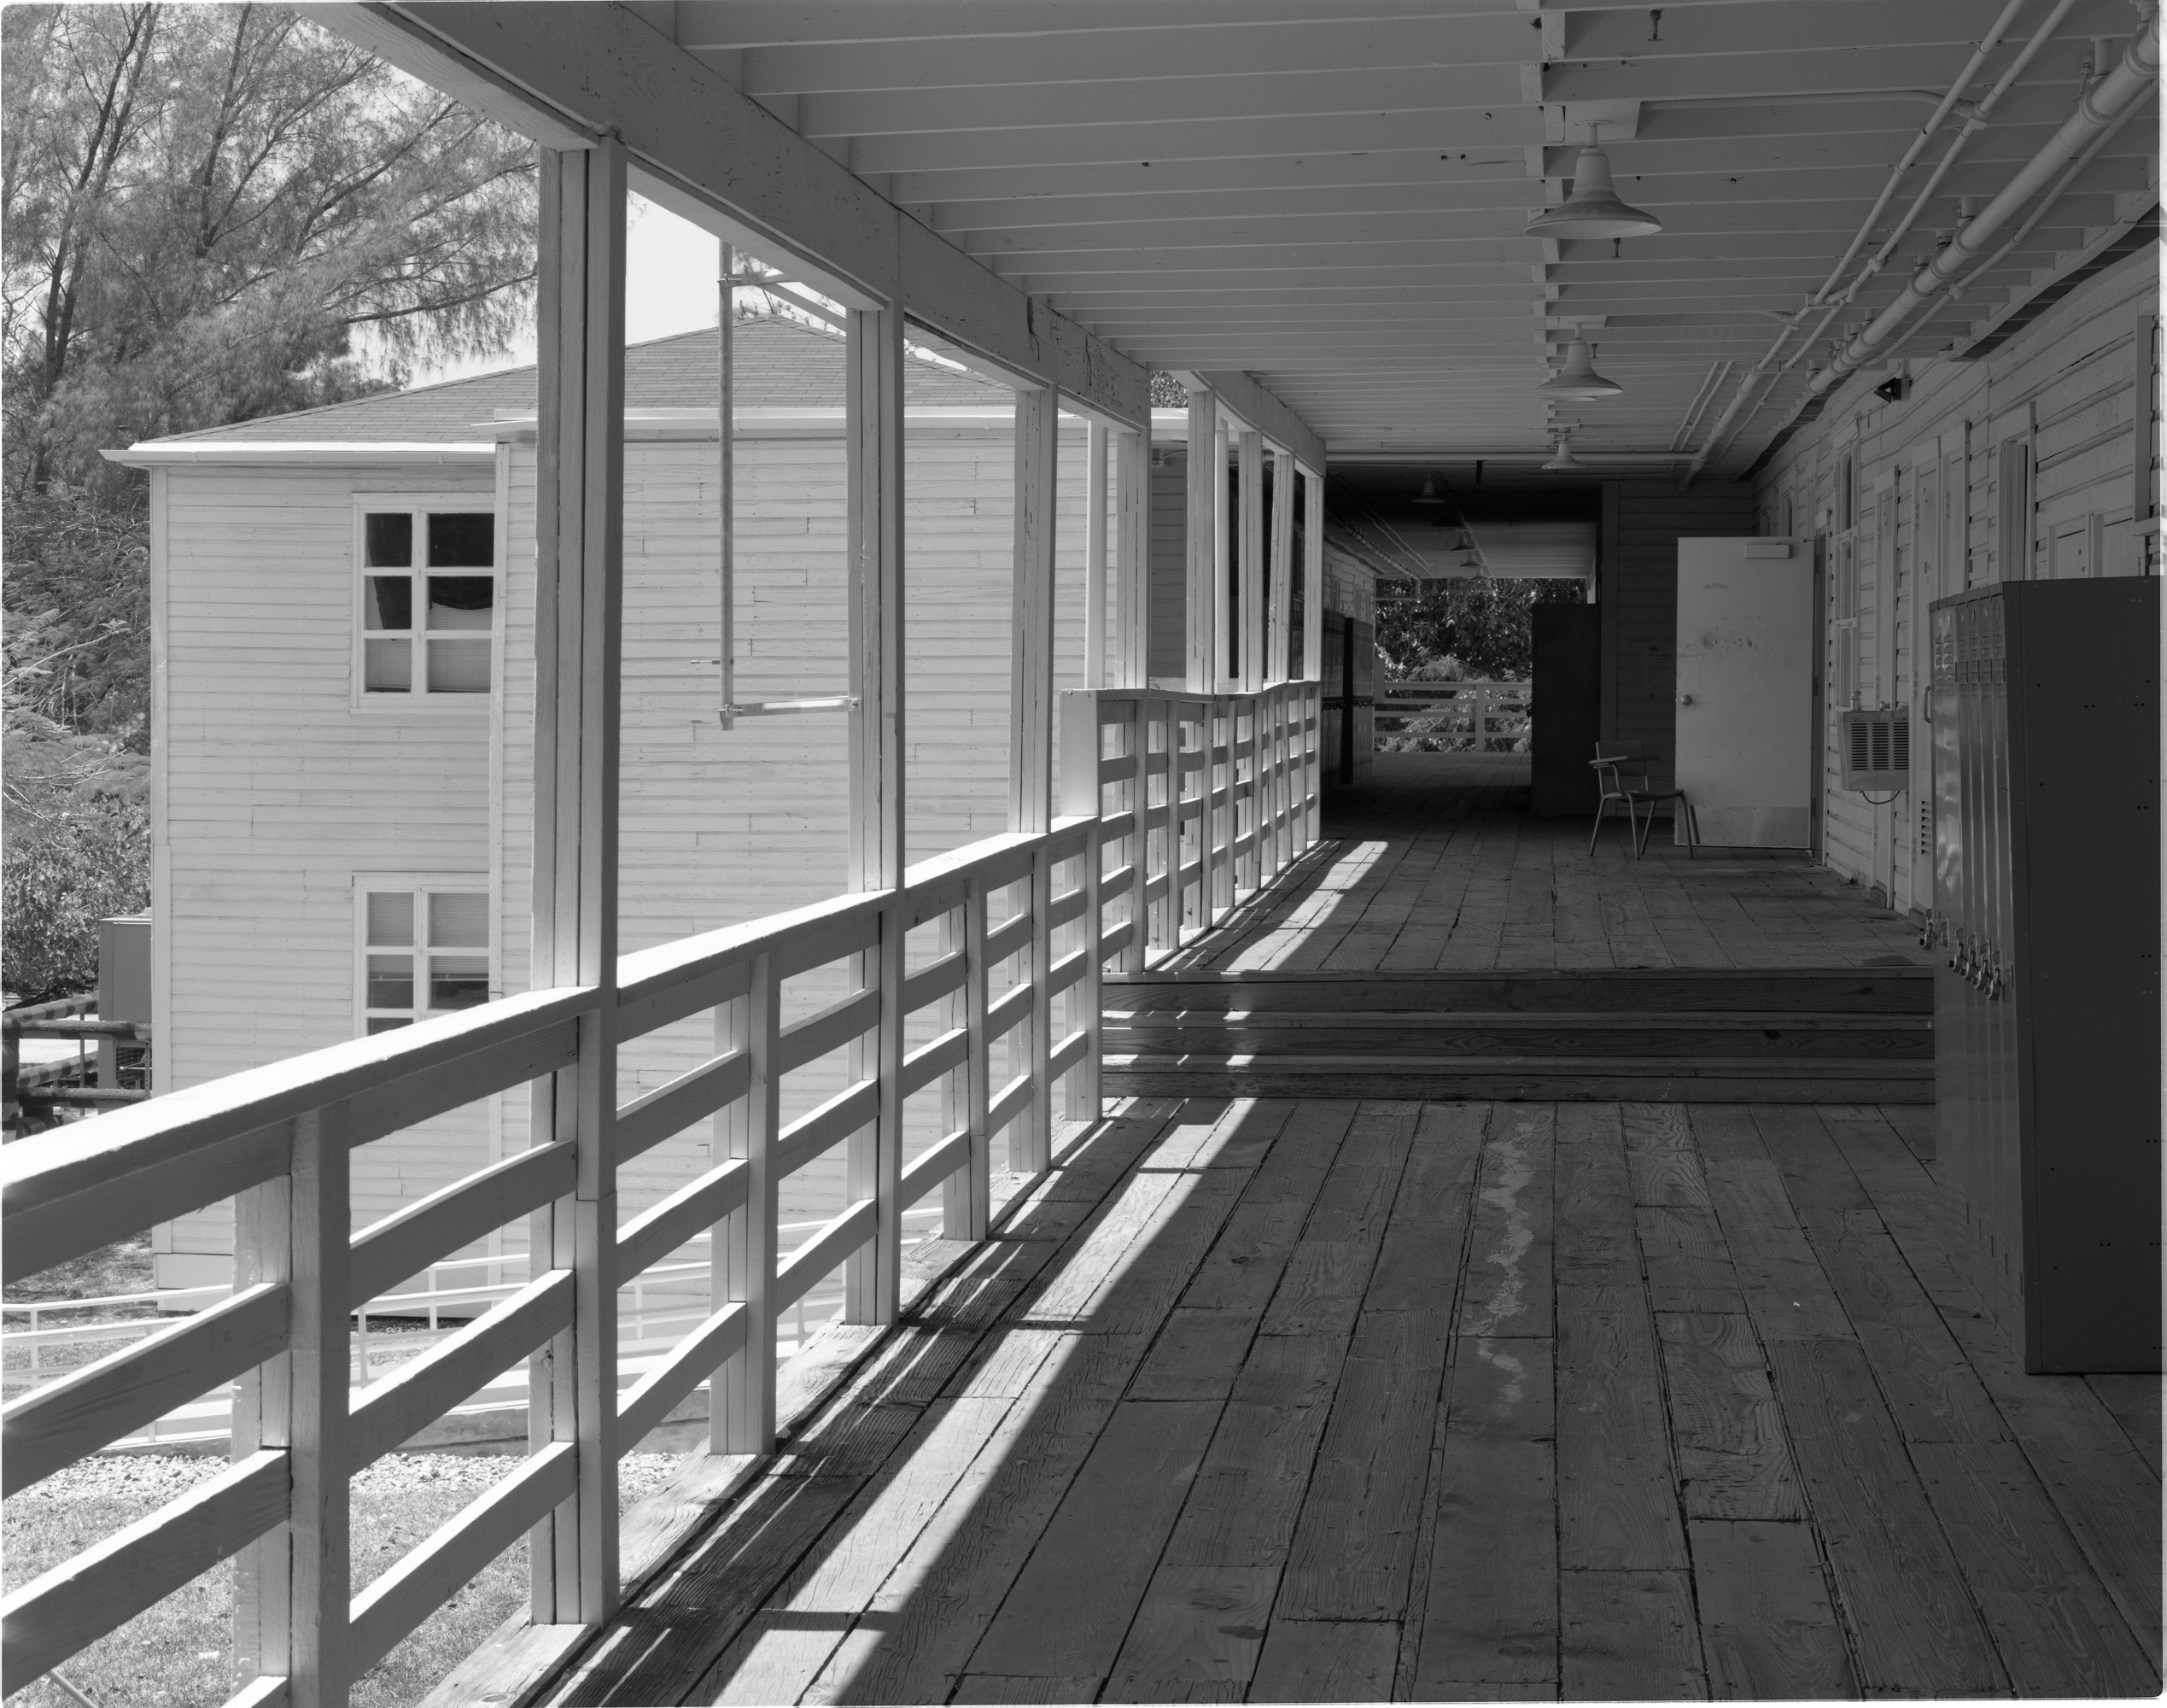
University of Miami 1987
Notes:
1987 Zone VI Tmax 100

